Slide 1
Keys Kitchen Remodel
John Decker
September – November 2015

Slide 2
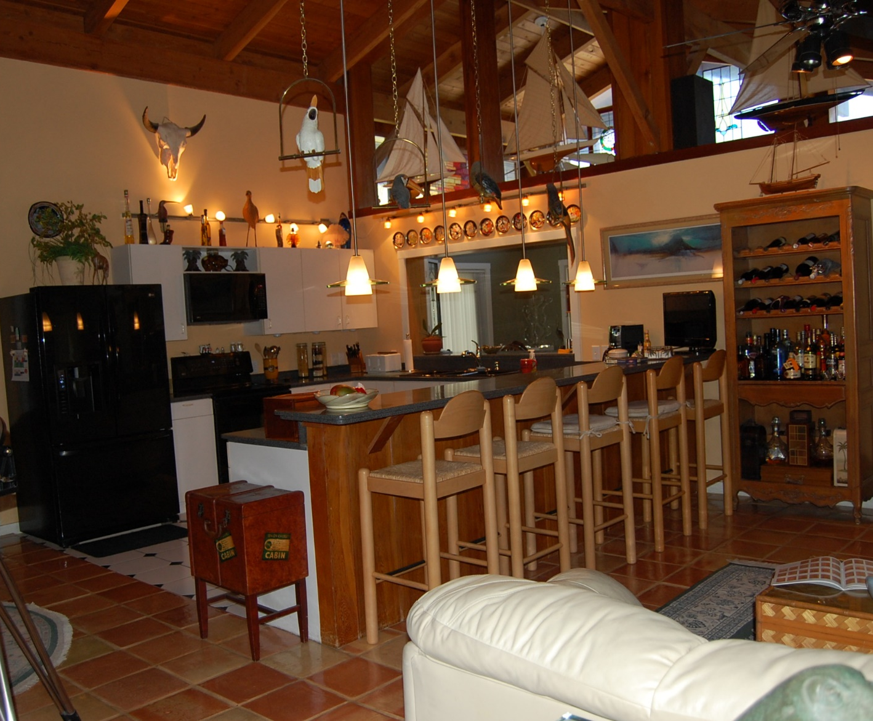
The “old” kitchen
It all started when Andrea was seated on the couch in the foreground. She noticed that it was a long walk around the counter to get to the wine cabinet or worse, the dining area on the other side of the pass-through. She thought there should be a passage from the sink/dishwasher area to the cabinet.
She was right. But doing that meant a whole lotta things had to be done first, such as re-tiling the floor.

Slide 3
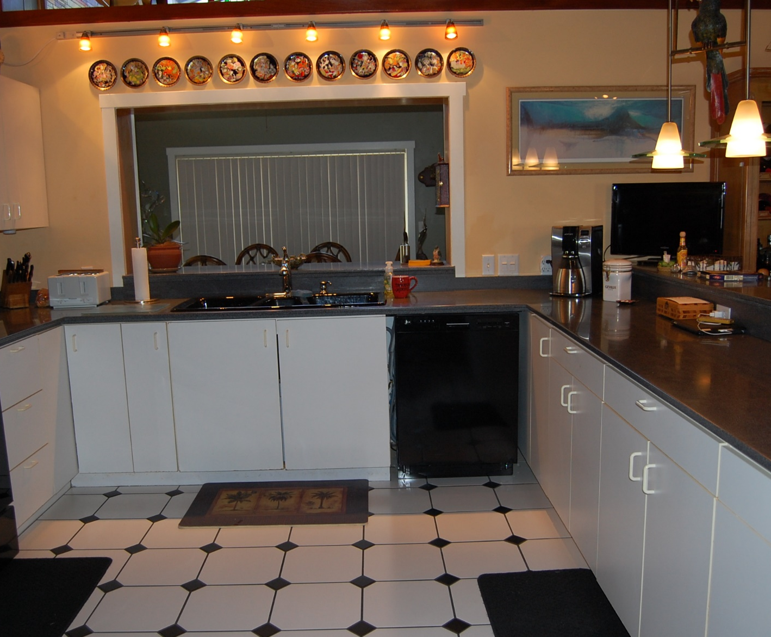
Other things we did not like
Just look at the space between the counter on the right and the stove on the left. Over 7’. That’s a long way to traipse when working on a meal.
Also, notice the black sink. Showed every hint of a waterspot. Cleaning it was a real chore, requiring vinegar and clear water.
Also, notice that the dishwasher had never been really fit in place; there was a gap all around it..
And though it doesn’t look like it, all that black, including the countertop, made the kitchen dark. I had added under-counter lighting, but it wasn’t enough.

Slide 4
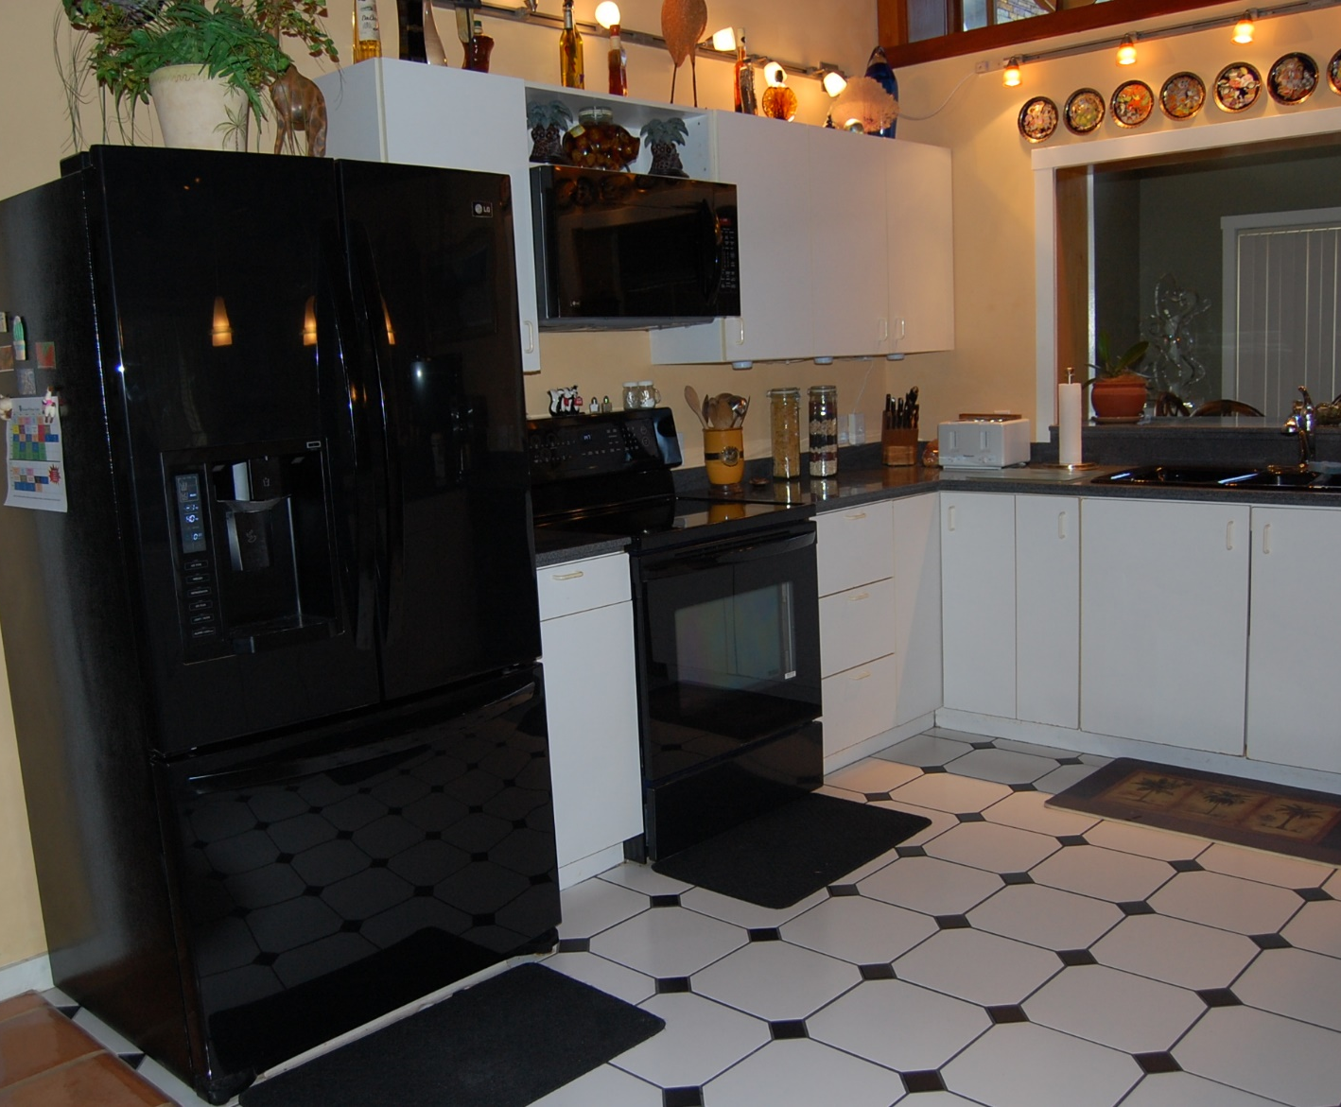
More things to correct
The black and white tile, though beautifully laid, didn’t mesh with any part of the house.
Notice that the kitchen looked kind of crowded and busy, too.
Once you start looking at your own place objectively, there is no end to the things you’ve got to do.

Slide 5
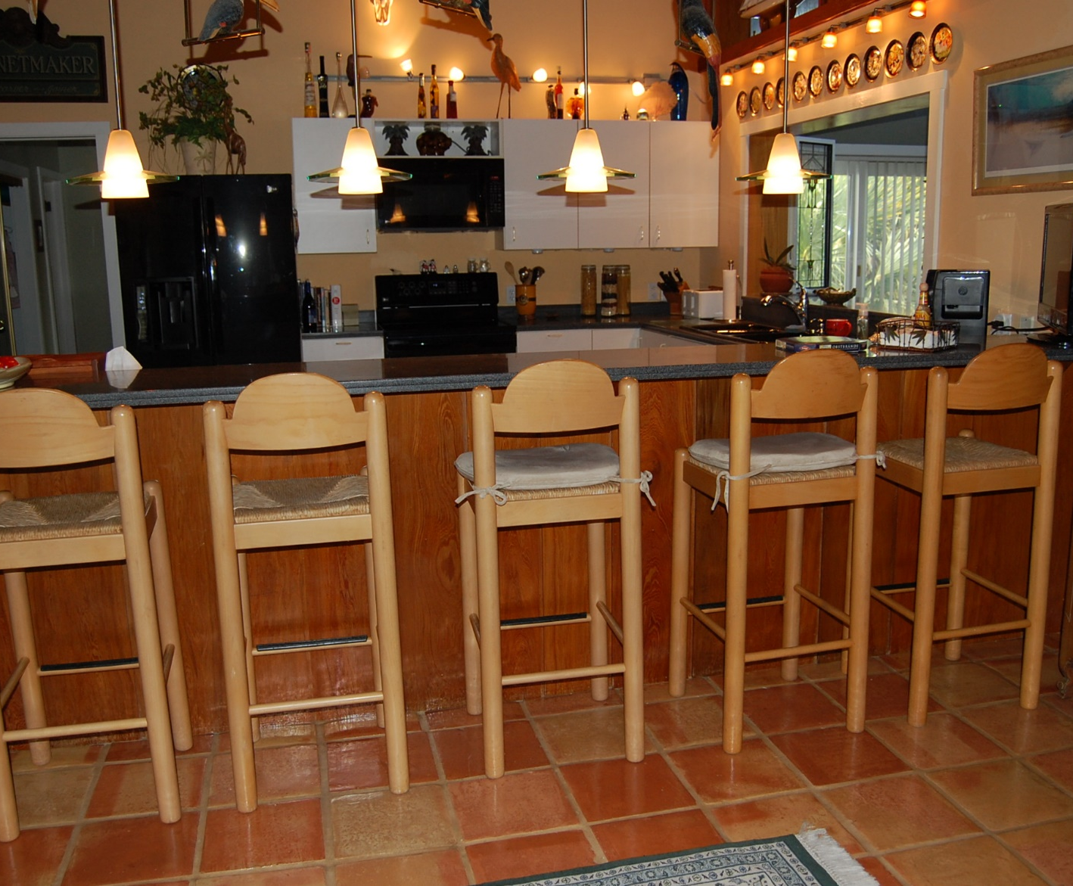
Another busy view
In retrospect, there wasn’t a square inch that wasn’t filled with something. Even if all the somethings were really nice, it was too much.

Slide 6
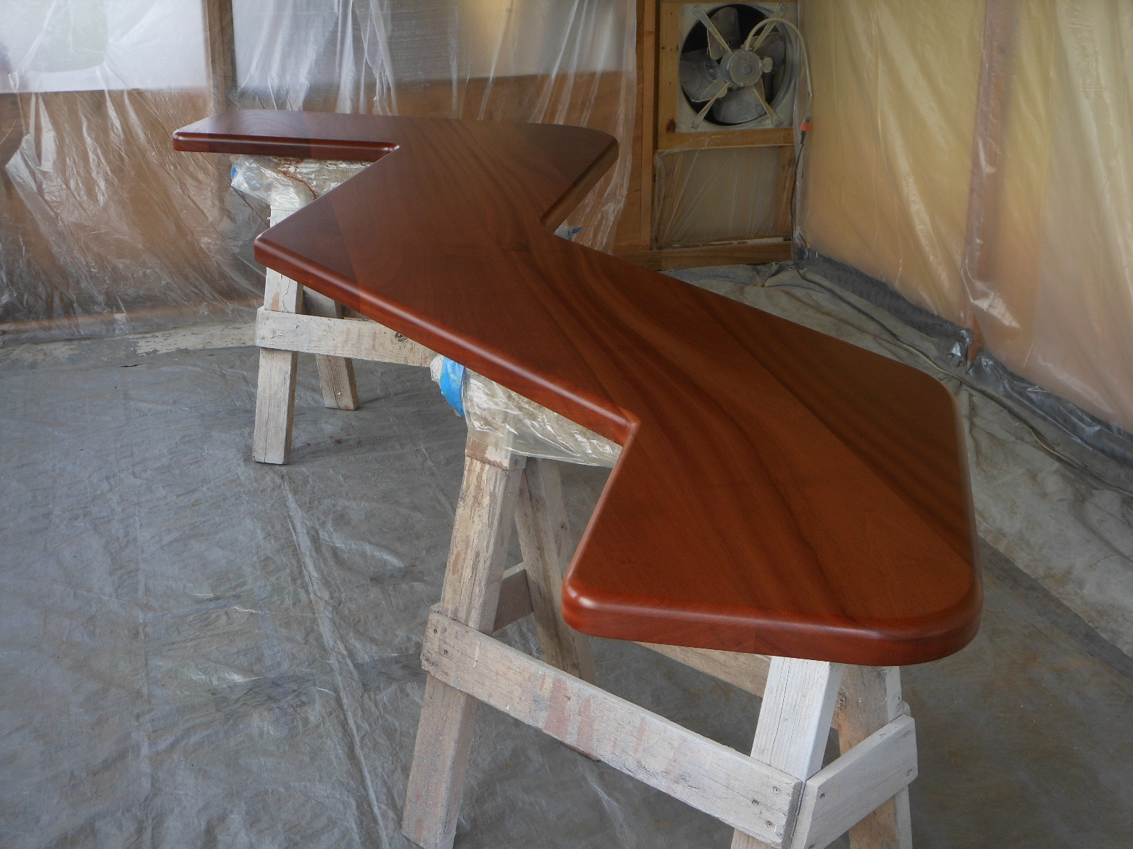
New Countertop Concept
John Decker single-handedly came up with this totally custom countertop that would become the focus of the entire room. He joined the countertop from 8/4 mahogany in Asheville and brought it with him to the Keys.

Slide 7
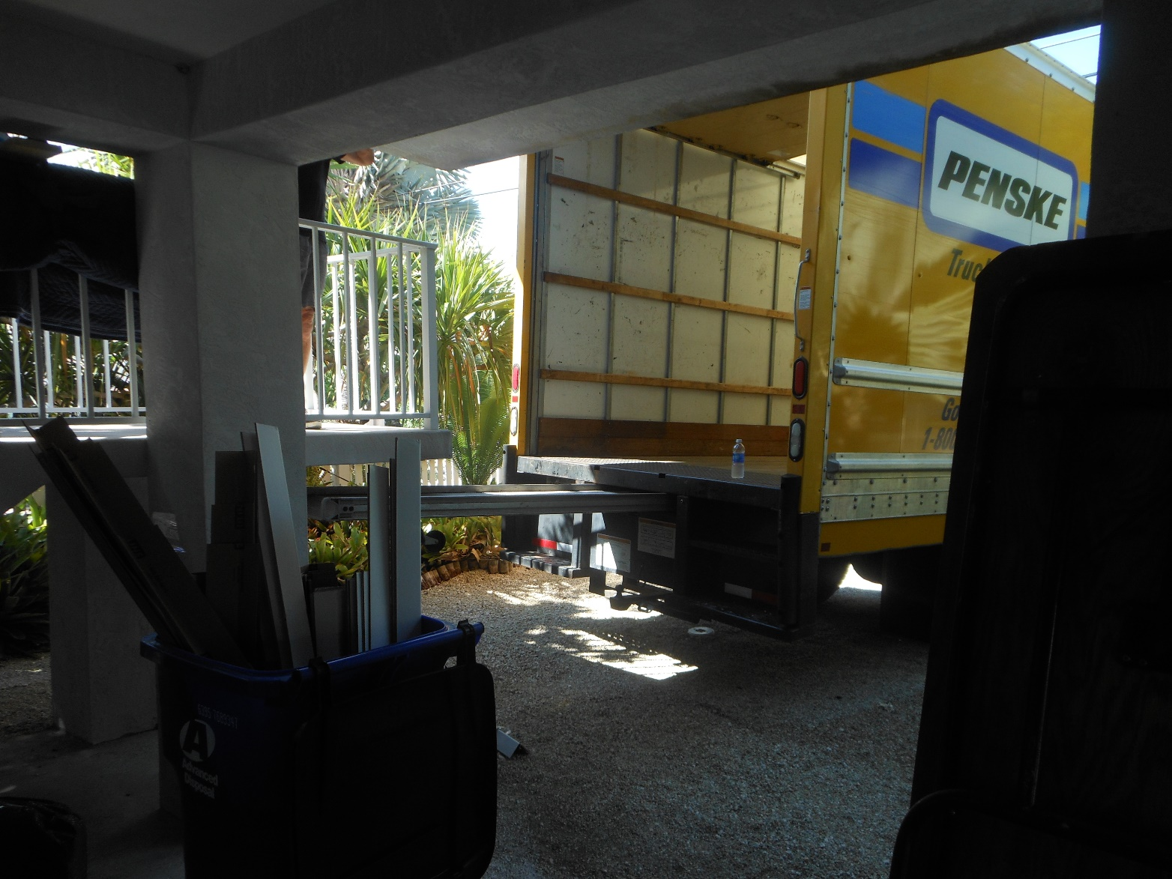
Offloading
John’s tools, the cabinets we had designed and the central bar/cooking island all had to be driven down. John’s brother did the honors.

Slide 8
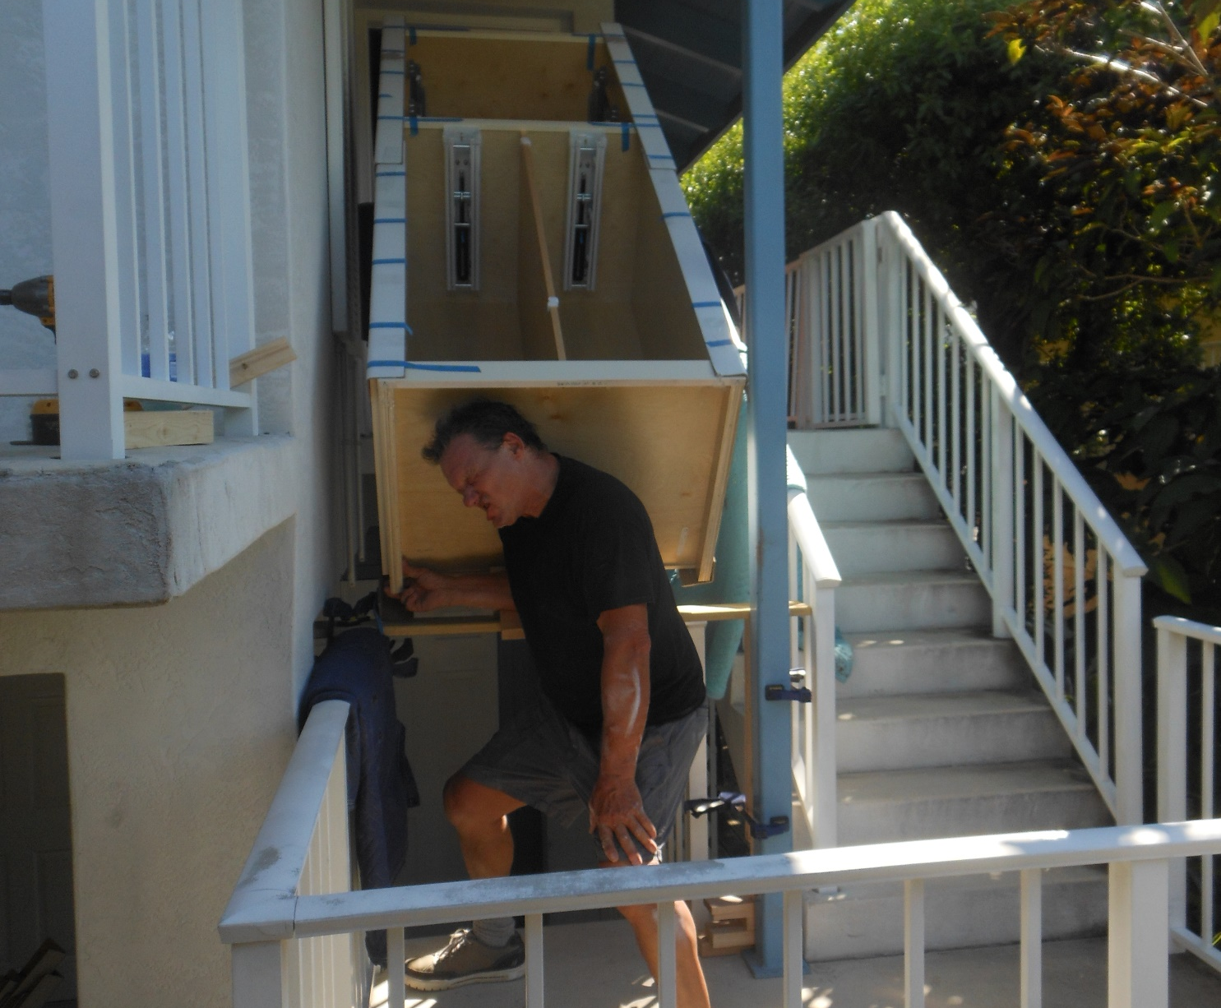
No cakewalk
John had been using a helper named Adam in Asheville, but because of custody issues, Adam couldn’t make this on work. Instead of it becoming a major setback, John got busy and found Derrick, a Keys wood sculptor who builds custom kitchens during his off-season.
John is meticulous, neat and smart. His co-worker had to be, too.
Everything John told me about this guy was good. He contributed many good ideas and many hours of highly skilled work.
This is a photo of the pantry being babied upstairs.

Slide 9
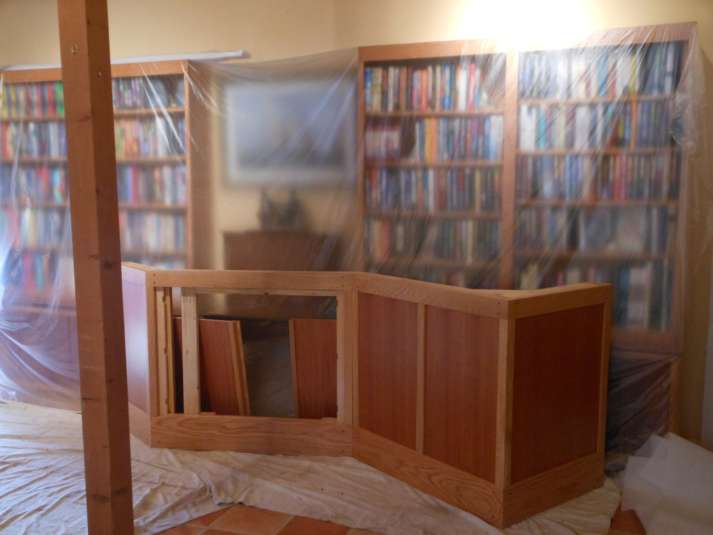
This is the bar island
Or the island bar, depending on how you think of it.
John took down every knick-knack and covered every opening with plastic to prevent dust from getting into everything.
For the first few days, the A/C didn’t work, either. But John handled that, too, calling my HVAC guys and getting everything squared away.

Slide 10
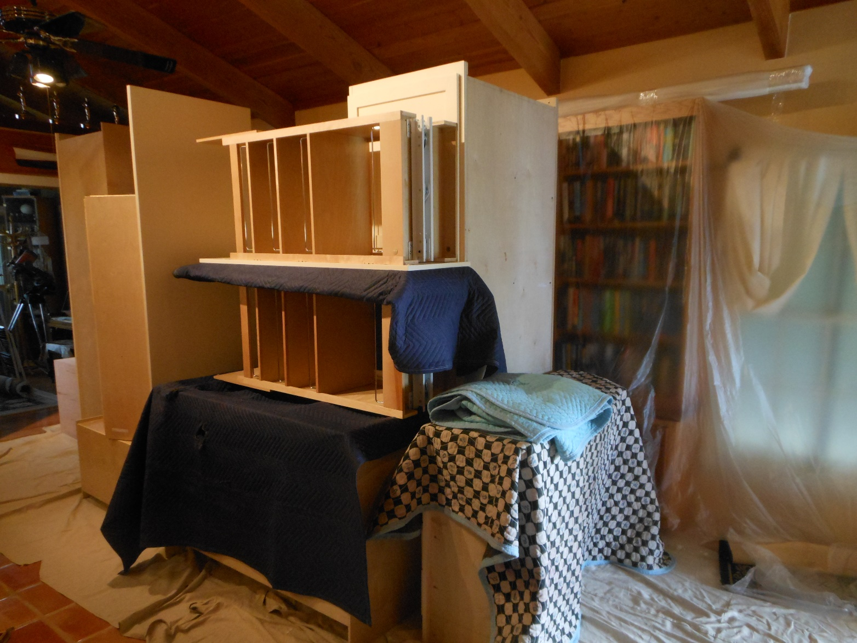
Stacked Cabinets
Extra care was taken not to mar the painted cabinets in any way.

Slide 11
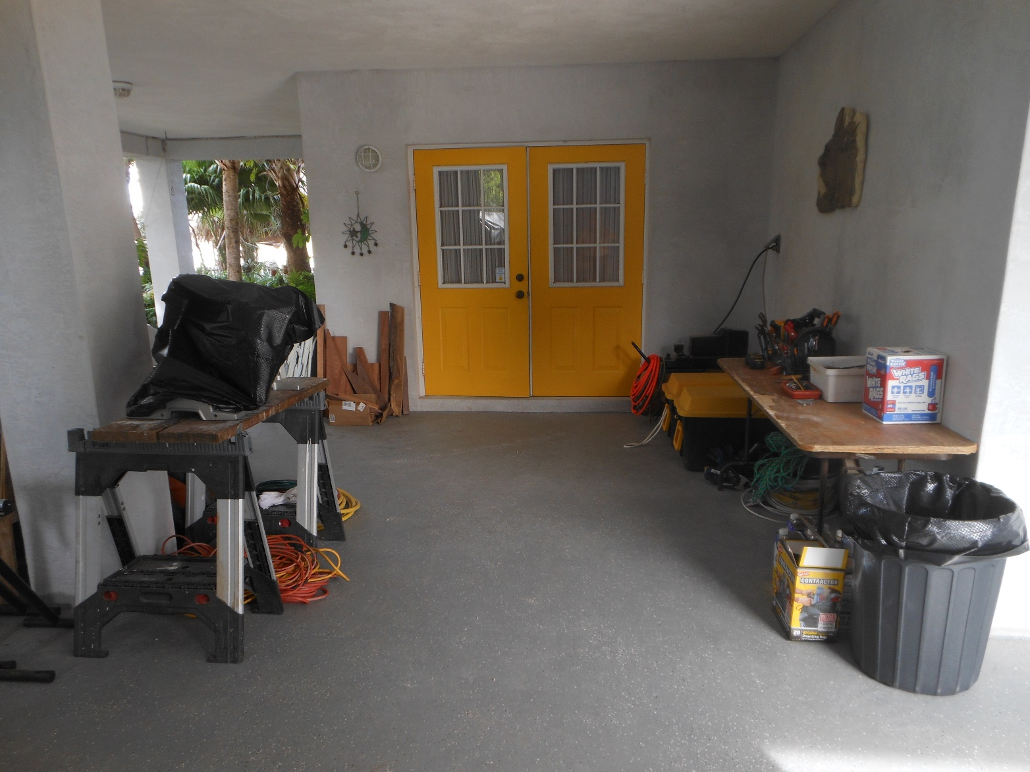
The Workshop
Notice the neat organization, typical of John.

Slide 12
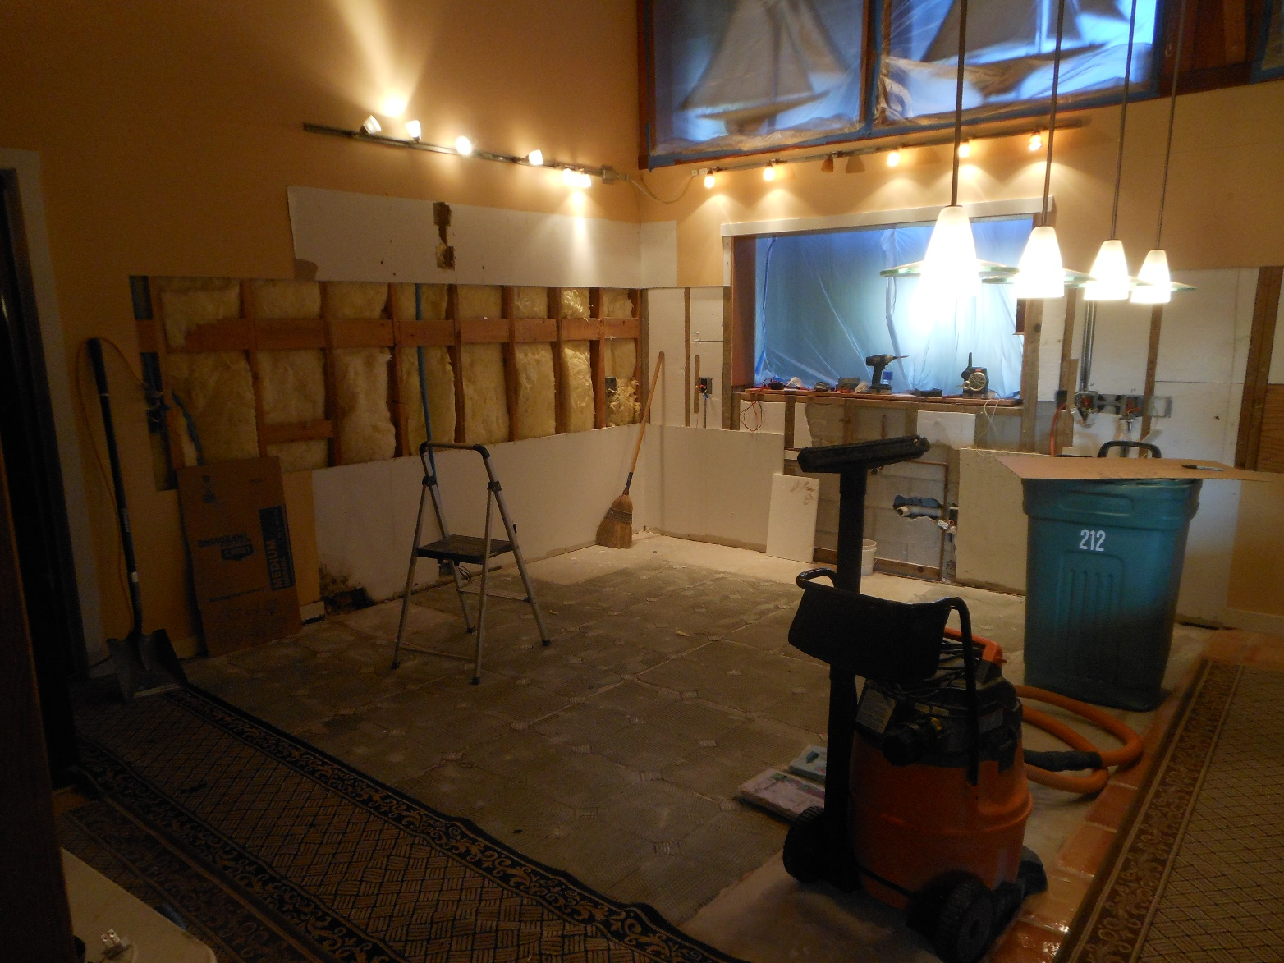
Removal of Tiles
No easy task, and likely the dustiest part of the job. Look carefully, though, and you will see that every opening is covered with plastic.

Slide 13
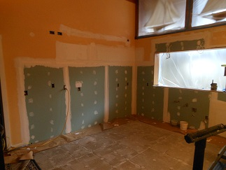
Drywall work
Once again, done to John’s high standards.

Slide 14
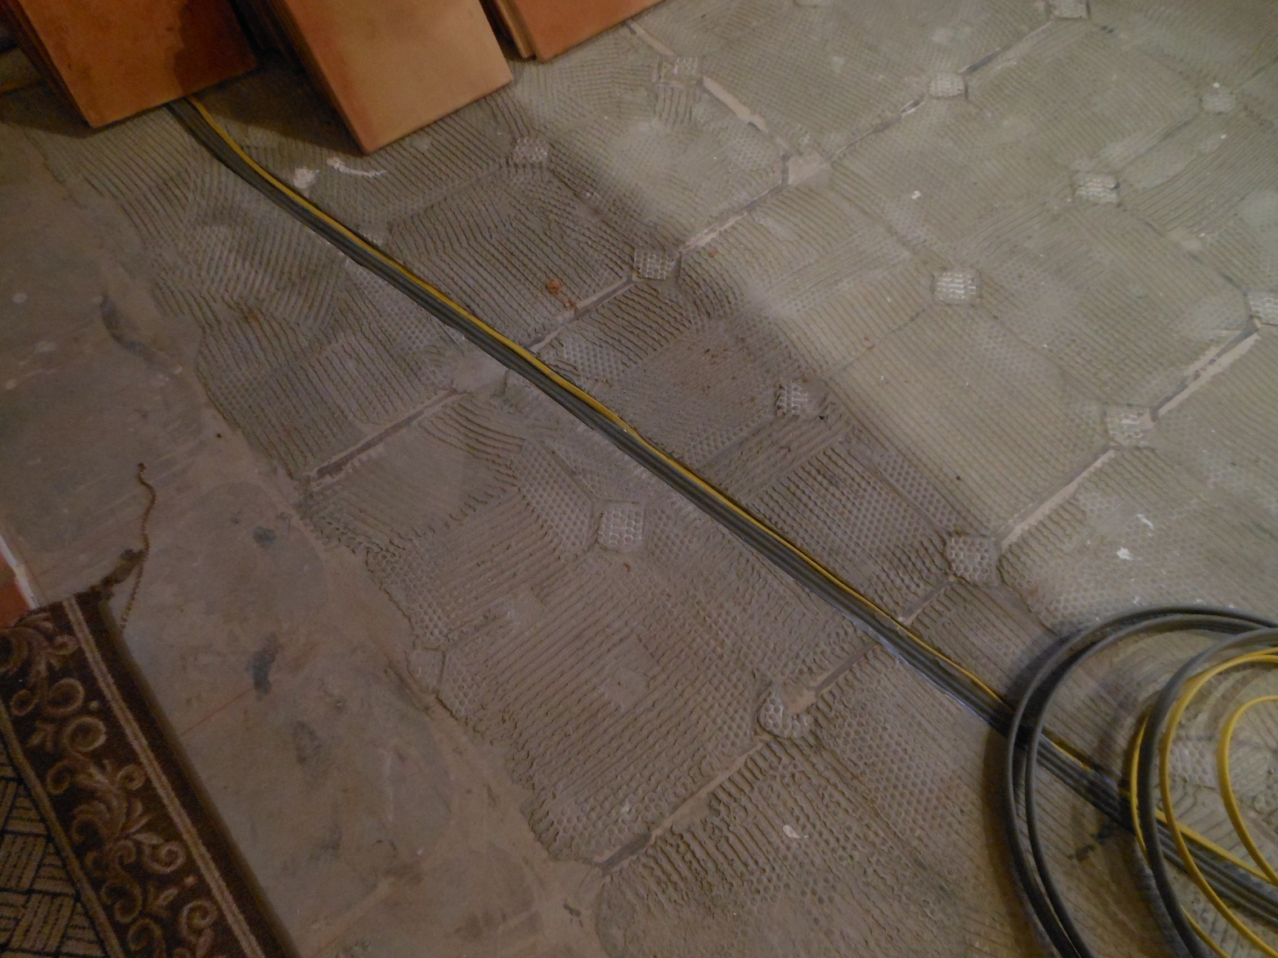
Laying the Electrical Cable
Since there were to be a great many appliances (including the oven and stove, the bar refrigerator, and more) on our island, power had to be run. This required channeling into the concrete floor directly above a support lintel.

Slide 15
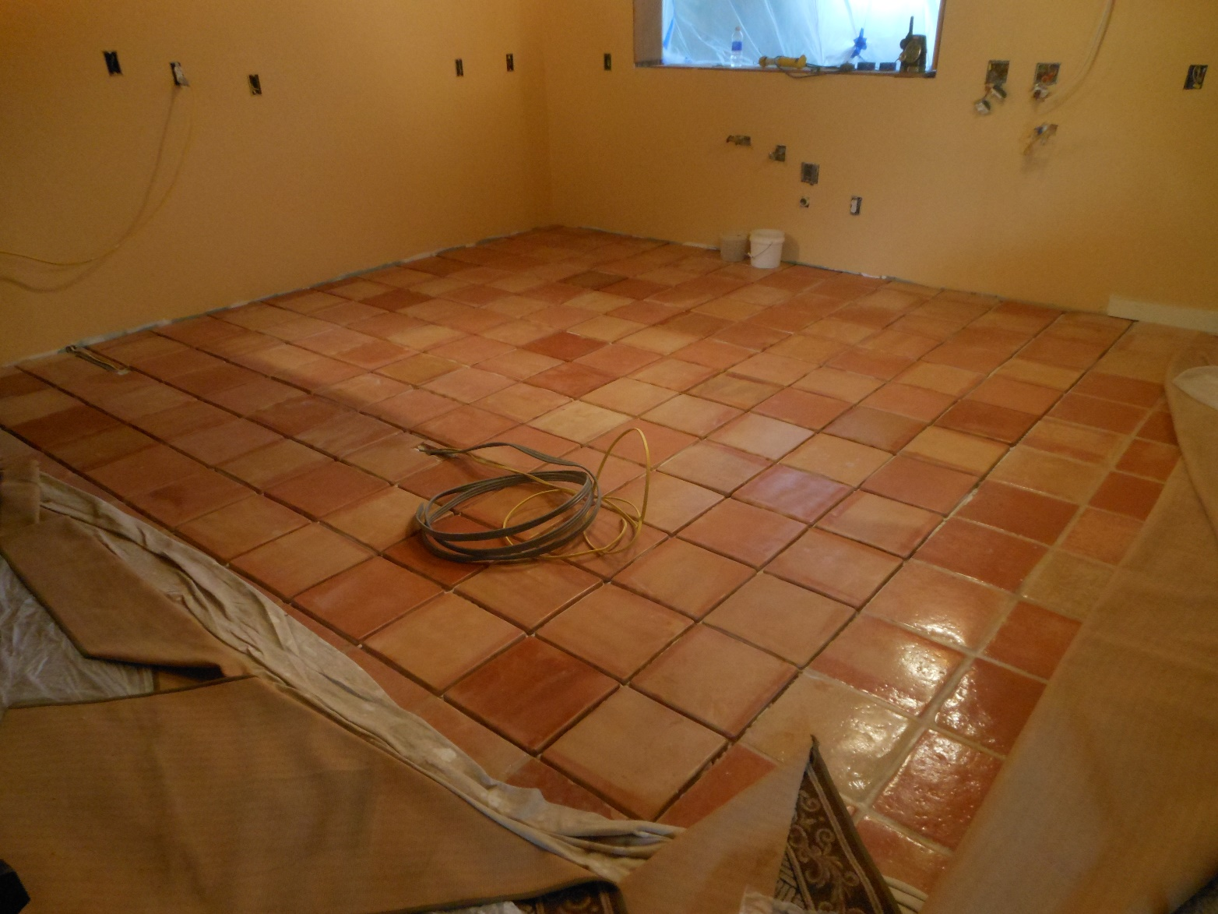
New Tile, Ungrouted
You can see where the electrical wiring had to protrude from the middle of the floor.
John had acquired exactly the same sealer that I used elsewhere so as to match the other tiles perfectly. Each new tile was too large. Every tile had to be cut down on two sides and beveled.

Slide 16
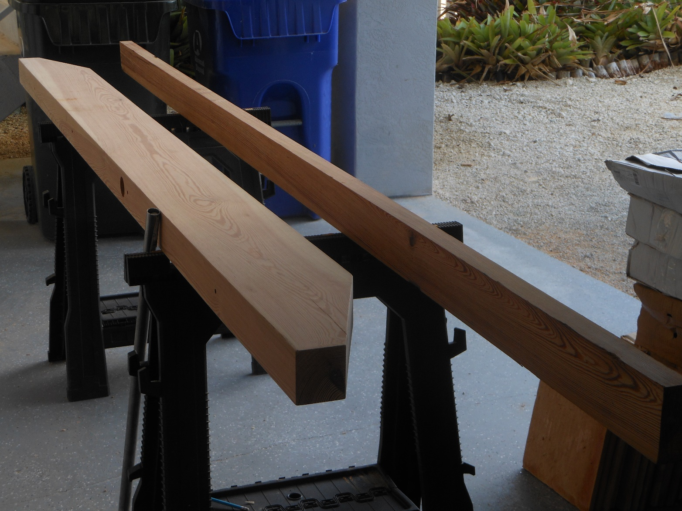
Lighting over the Bar
The whole Keys house uses Dade County Pine, which no longer is available anywhere. John found a source of old wood, bargained for and purchased it. These two pieces would eventually become our overhead lighting fixtures. They matched the ceiling perfectly once a little linseed oil was applied.

Slide 17
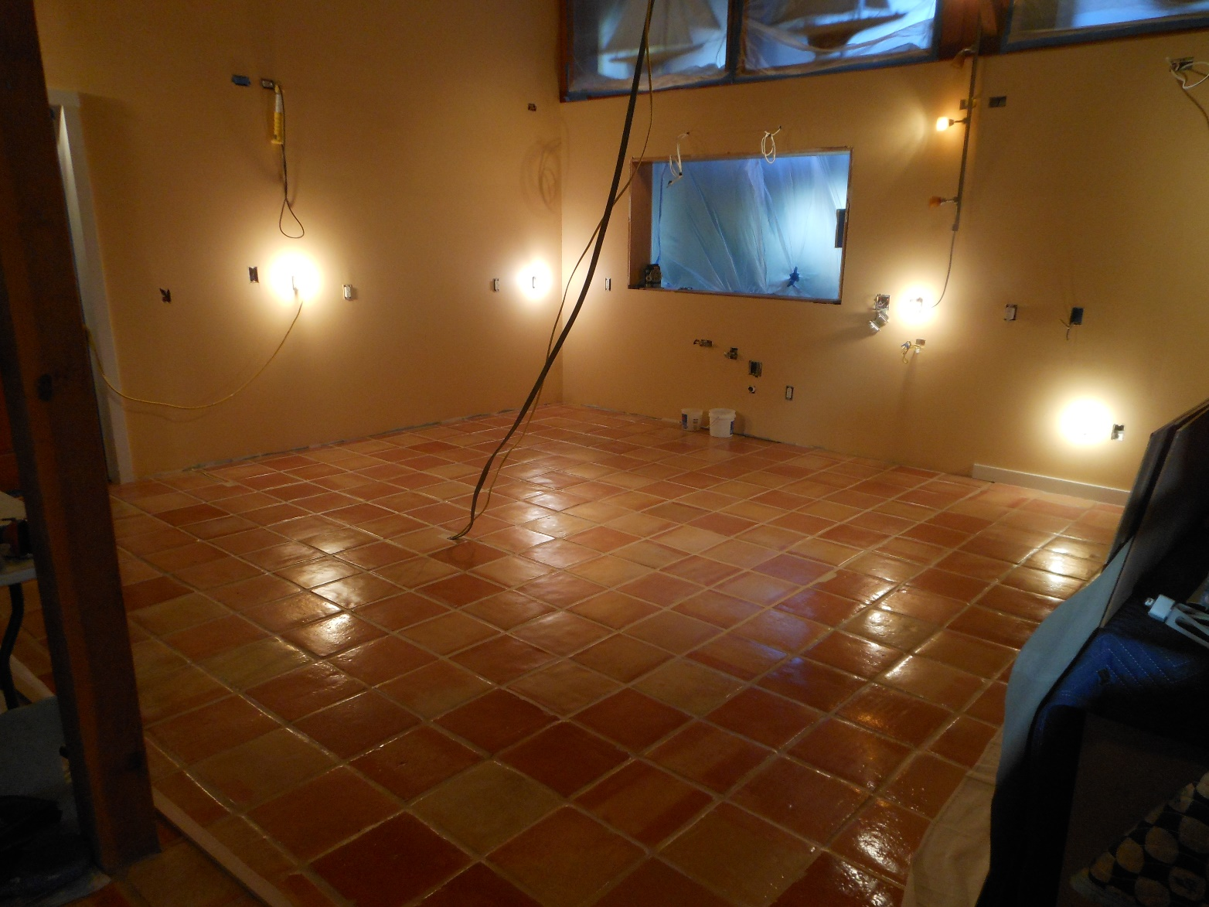
Grouted Tile
Also notice the freshly painted walls, even though none of this would show. Another example of John’s outstanding work ethic and craftsmanship.

Slide 18
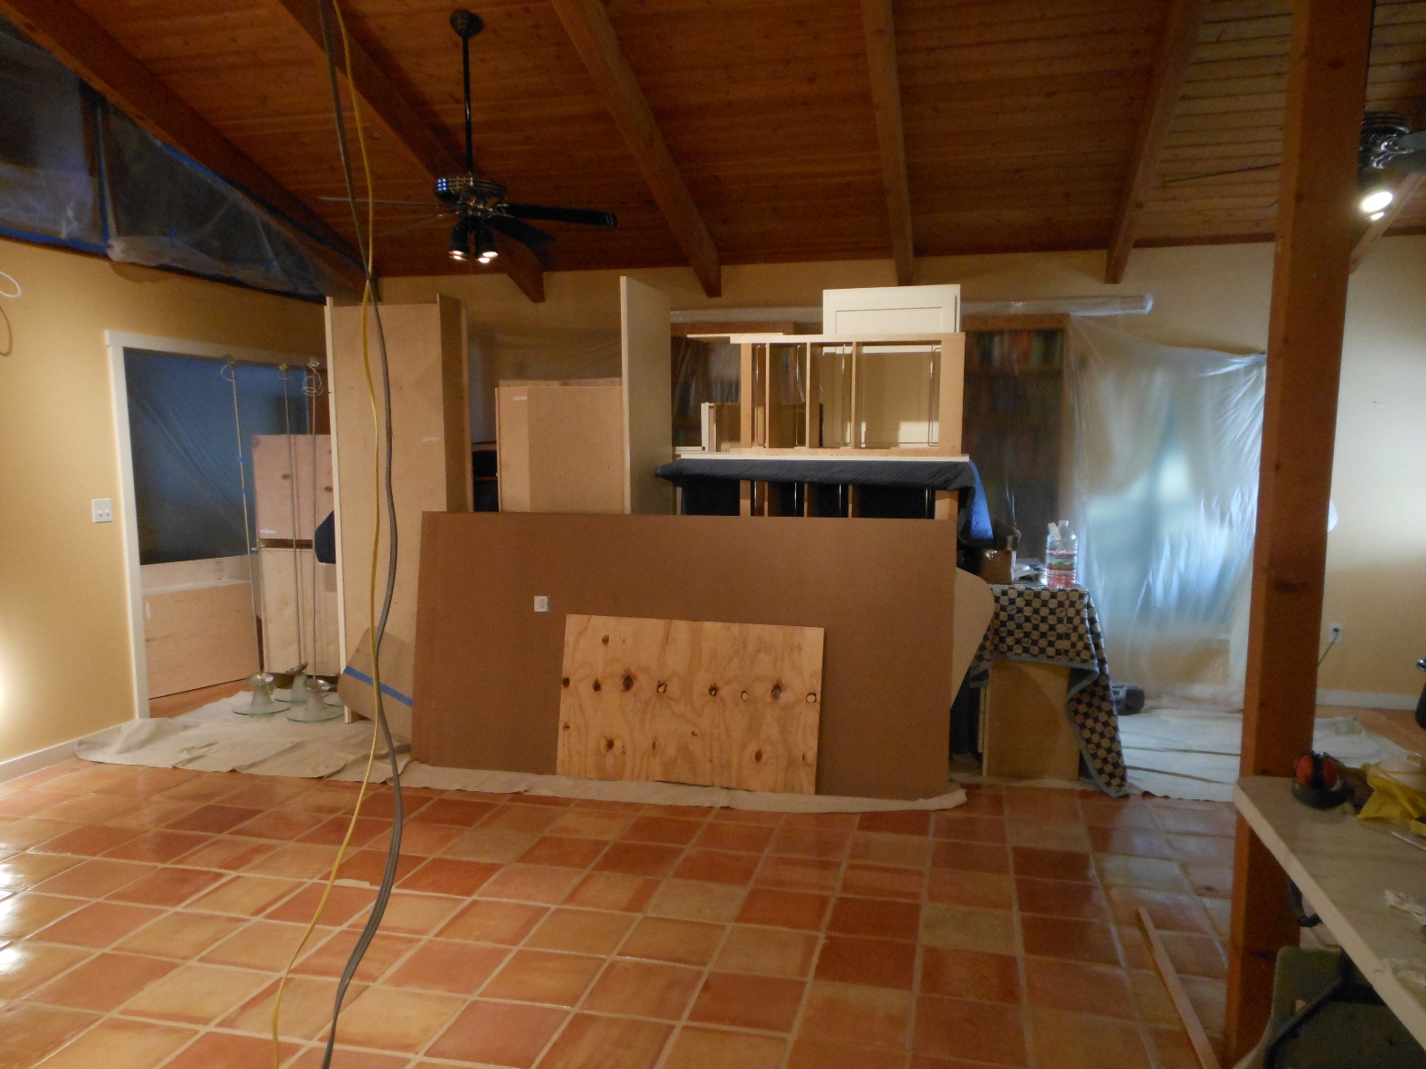
Near-Perfect Match
The new tiles blend flawlessly with the old tiles. John was careful to select a grout that was a near-perfect match.

Slide 19
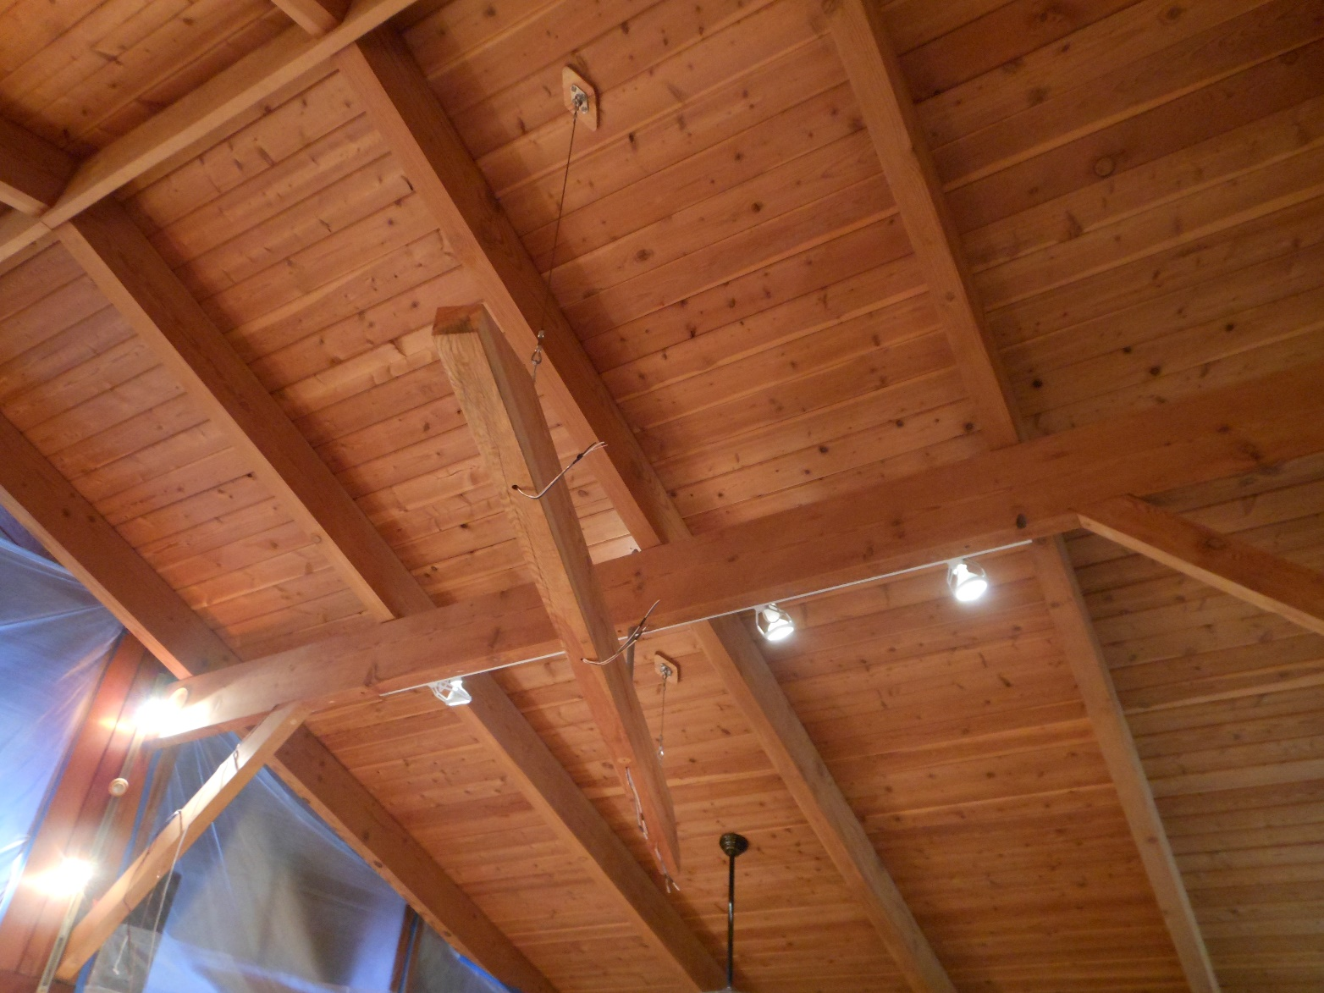
Light Fixture Hung
Look at the match here, too. Looks like it was added at the same time as the rest of the ceiling, doesn’t it?

Slide 20
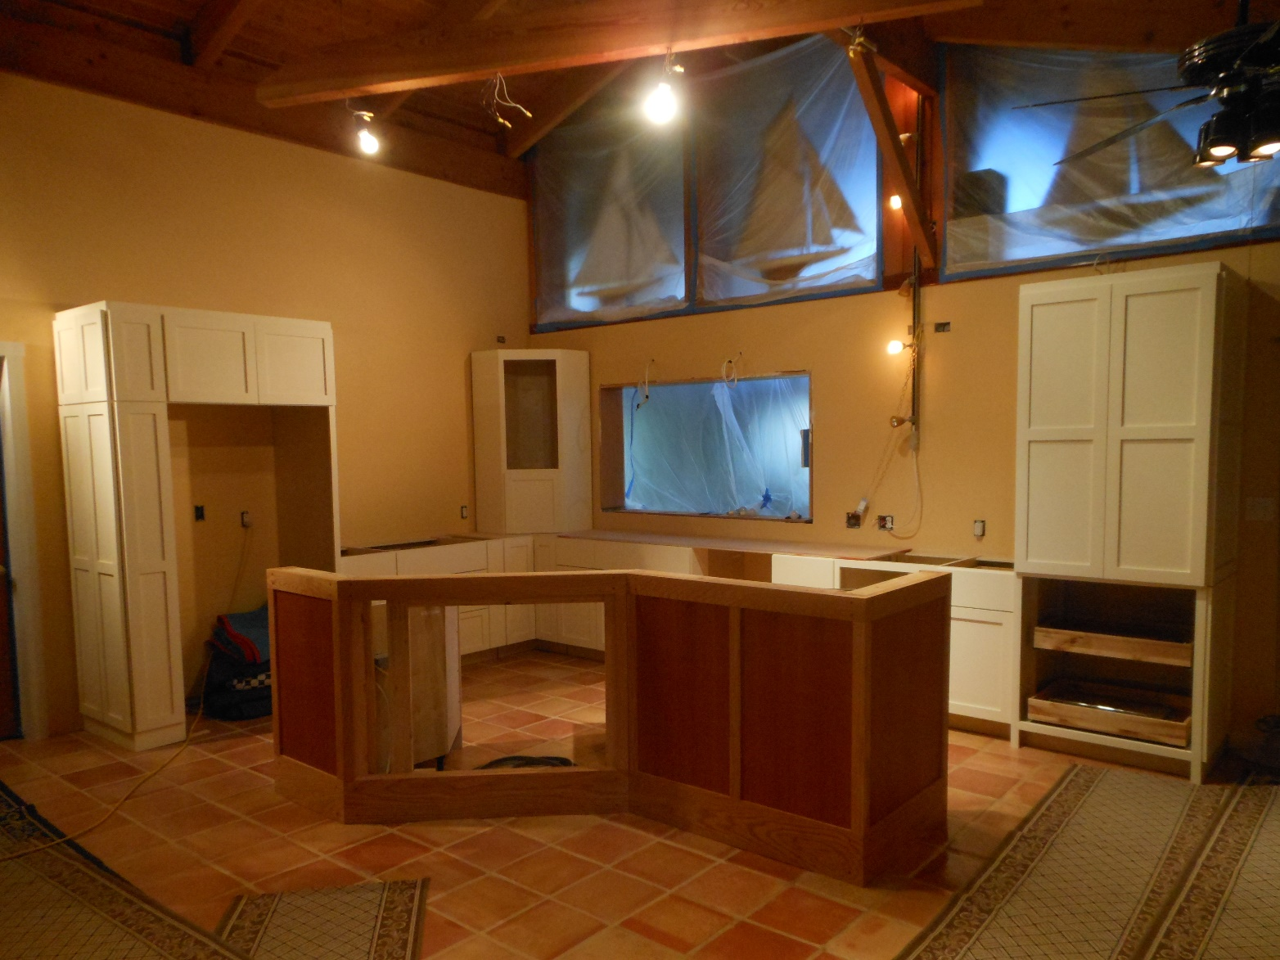
Placement of First Cabinets
Here’s where it starts coming together. All we can see in Durham are photos that John sends us almost daily, but both Andrea and I are getting more and more excited.

Slide 21
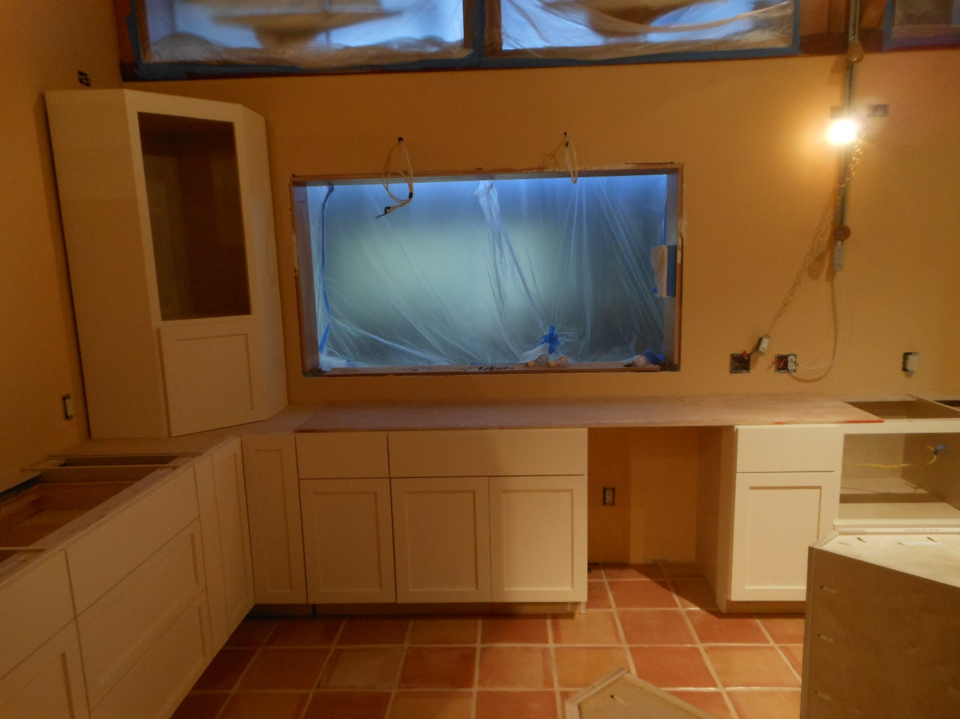
Another View of the Cabinets

Slide 22
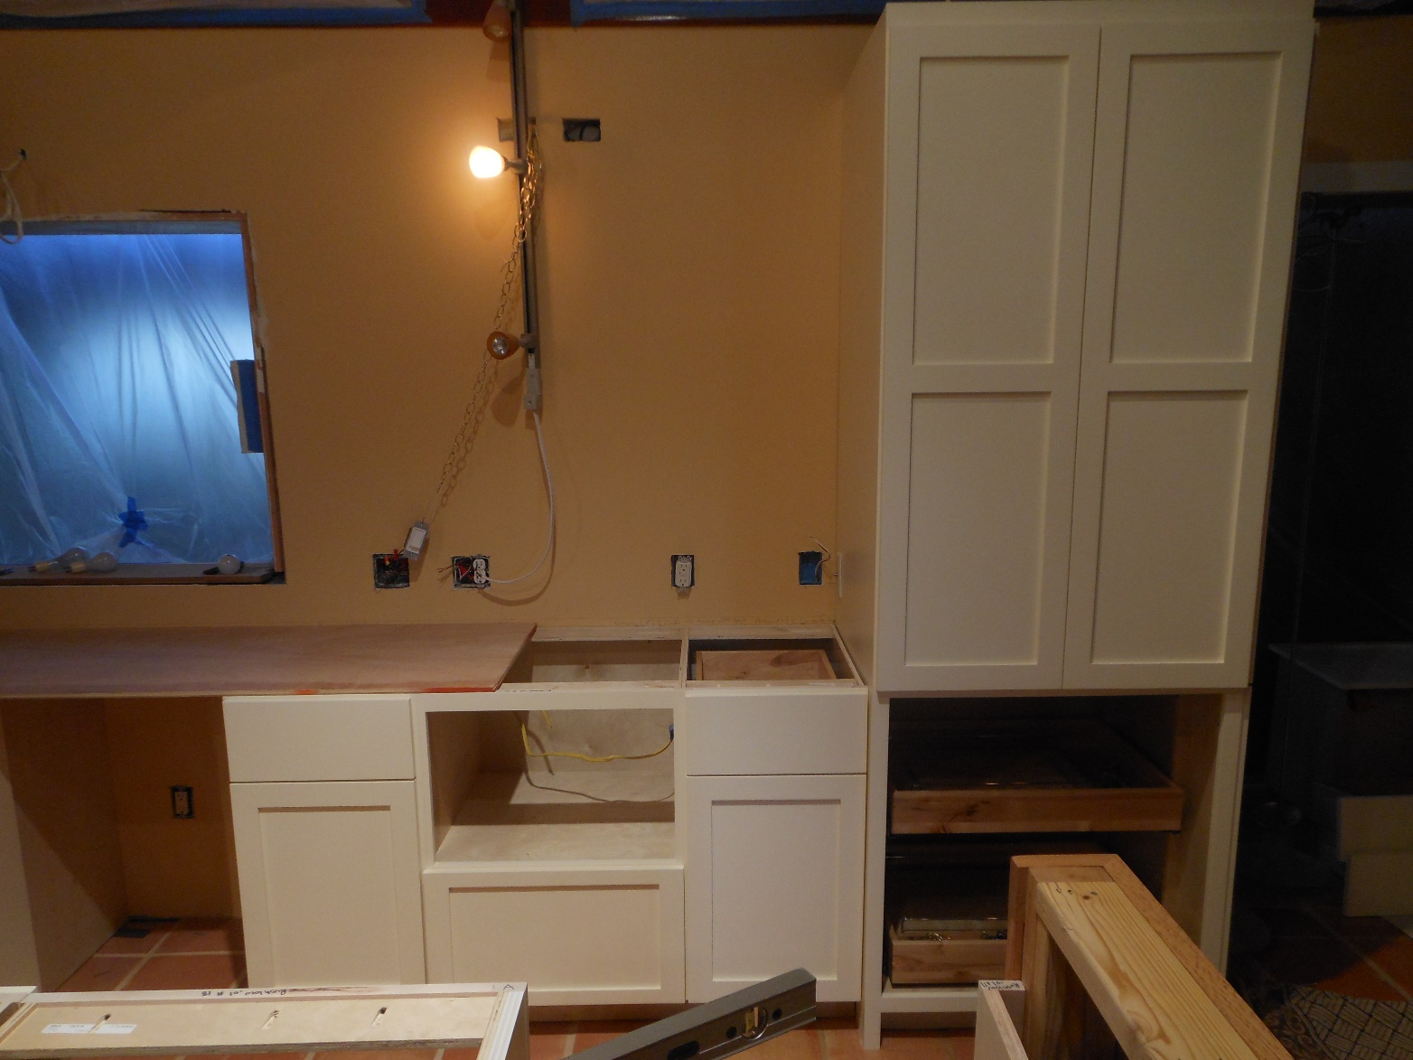
Another View
Pantry to the right, microwave drawer dead center, island in the foreground.

Slide 23
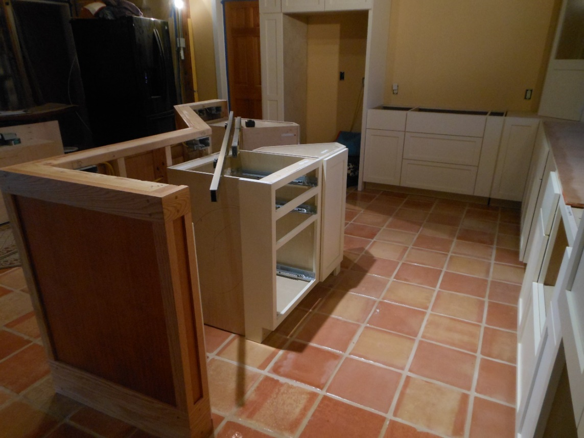
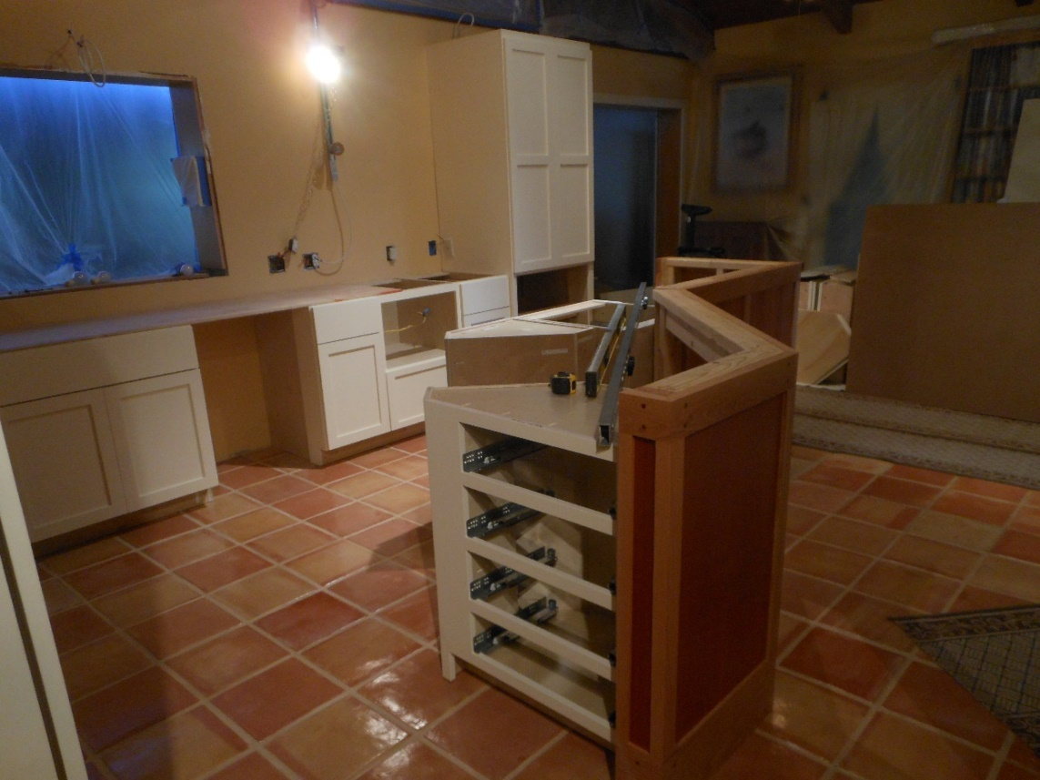
Two Additional Views

Slide 24
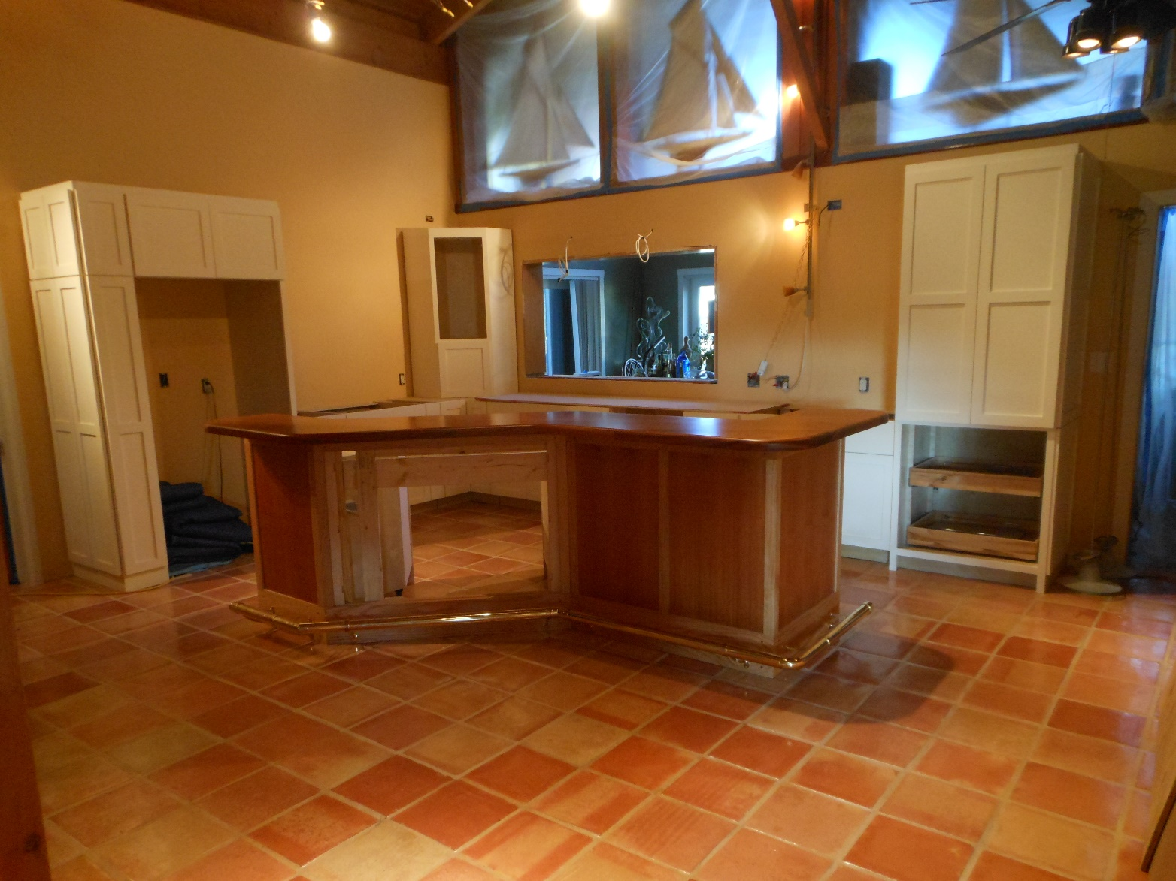
The Island Bar
The brass rail looks perfect! The mahogany bar/counter top matches the mahogany used elsewhere throughout the house, especially in this room. It is found in the living/dining room on the other side of the passthrough, too, as well as in the office.
The oak matches the oak used in the bookshelves throughout the house. This Island Bar was intended to be the segue between the kitchen cabinetry and the rest of the house. Funny, one reason we chose polished brass was to match the swings our carved leather birds sat on. We ultimately got rid of the swings, but not the birds.

Slide 25
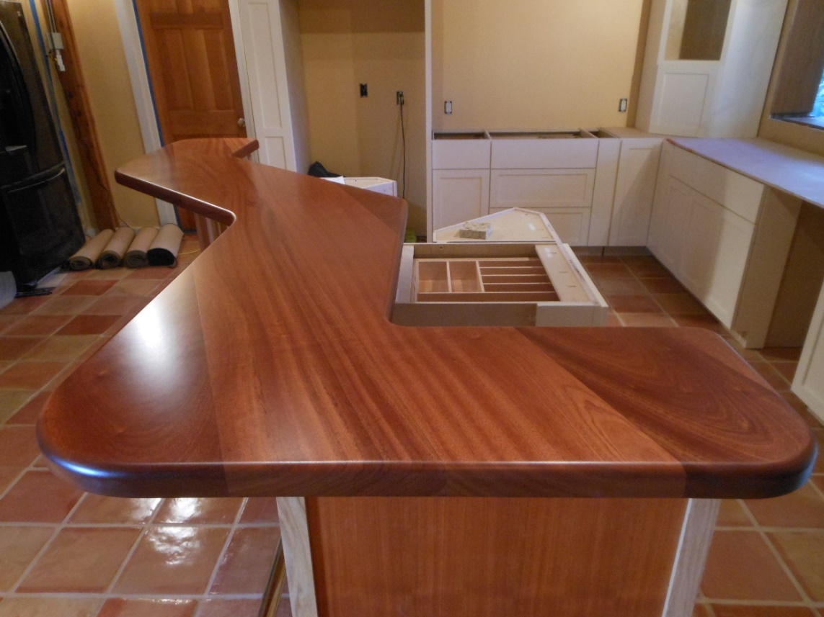
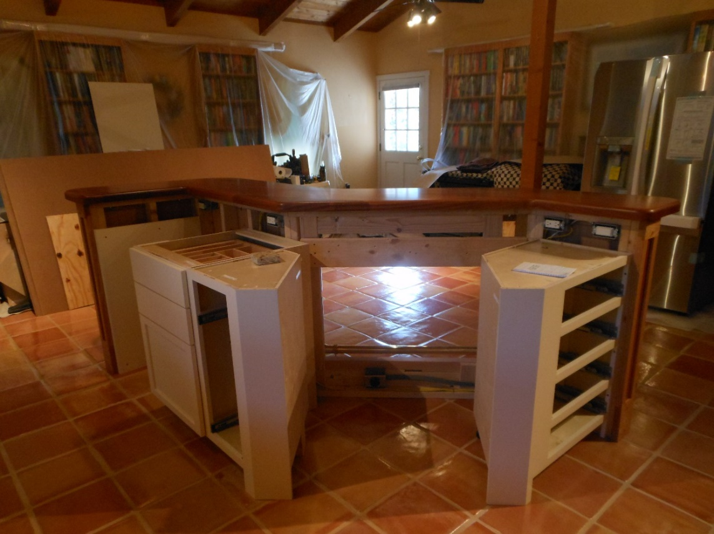
Beautiful Woods, space for Oven and Refrigerator

Slide 26
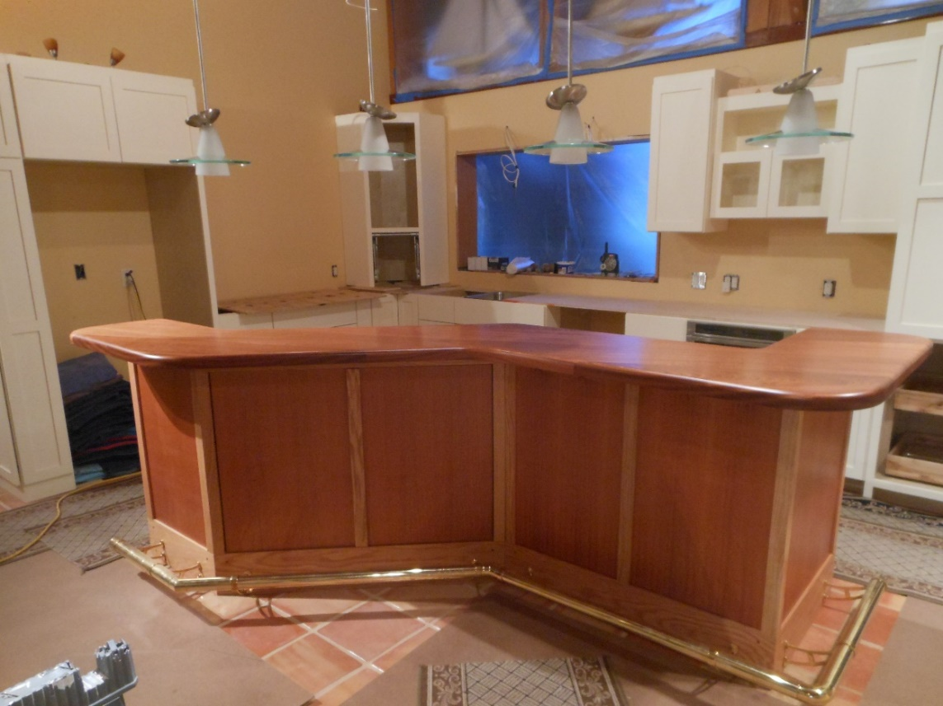
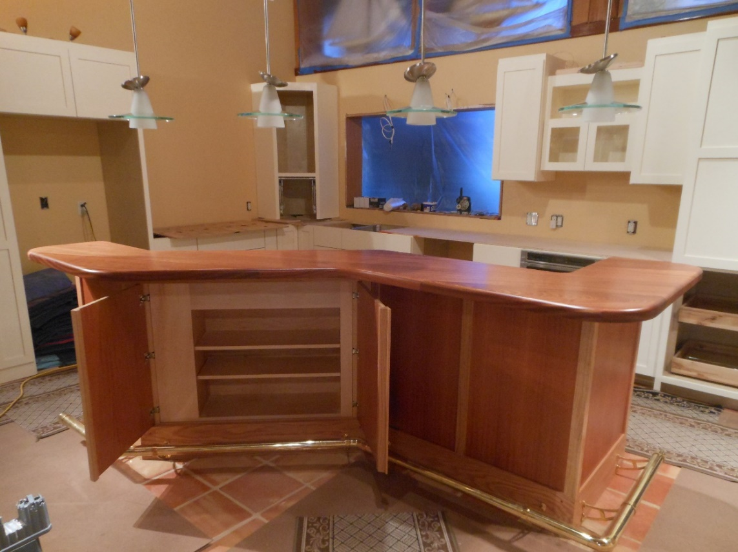
Island storage, perfectly hidden, Designed to hold a set of beautiful, But rarely used dishes.

Slide 27
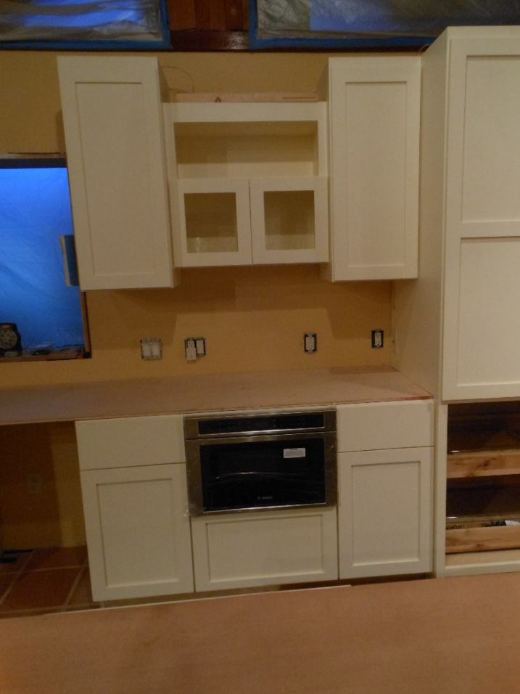
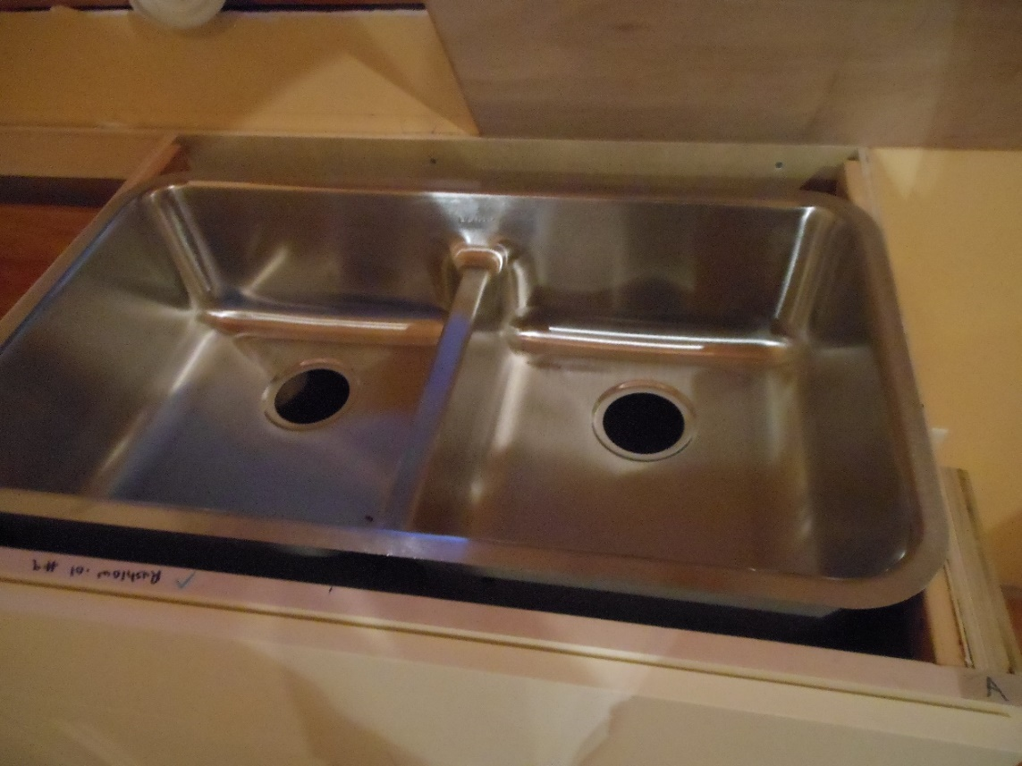
Bosch Microwave Drawer, Elkin “Smart” Sink.

Slide 28
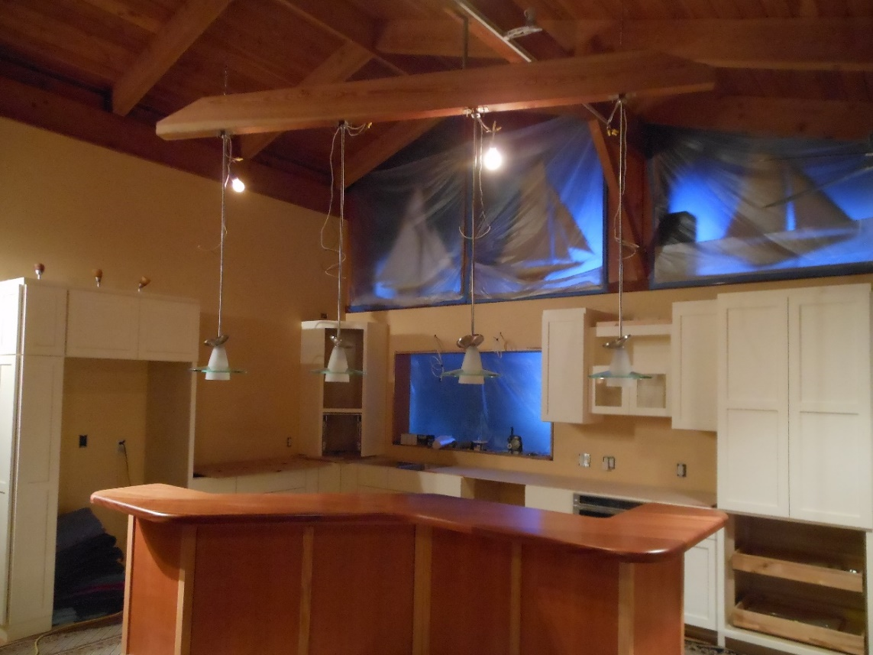
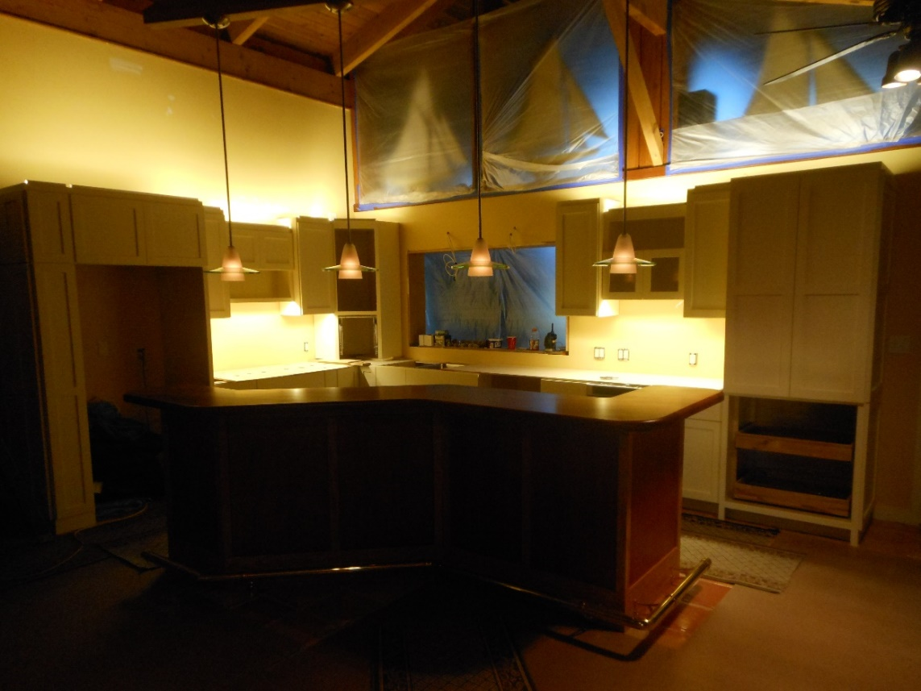
Let there be light! Much of the lighting is on rheostats (dimmer switches) for mood alteration.

Slide 29
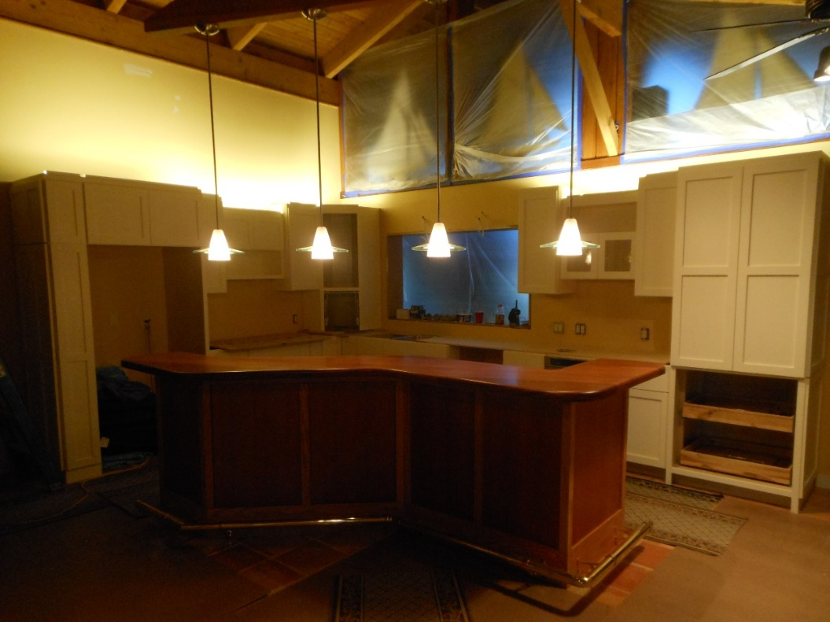
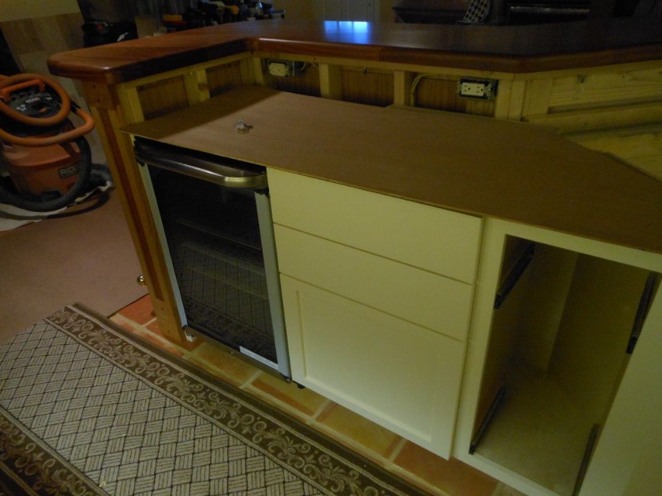
Lighting progresses, bar reefer installed
This is the first photo we saw of the lights with the wiring completed. These lights, like many others in the kitchen, are on dimmers switches.
The idea of a bar refrigerator is not only to free up space in the main unit, but to provide handy access to beer and chilled wines.

Slide 30
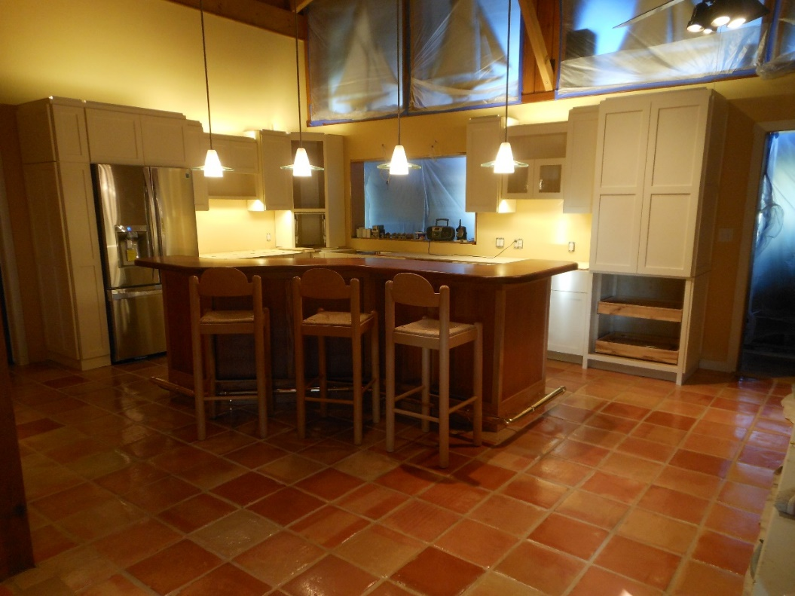
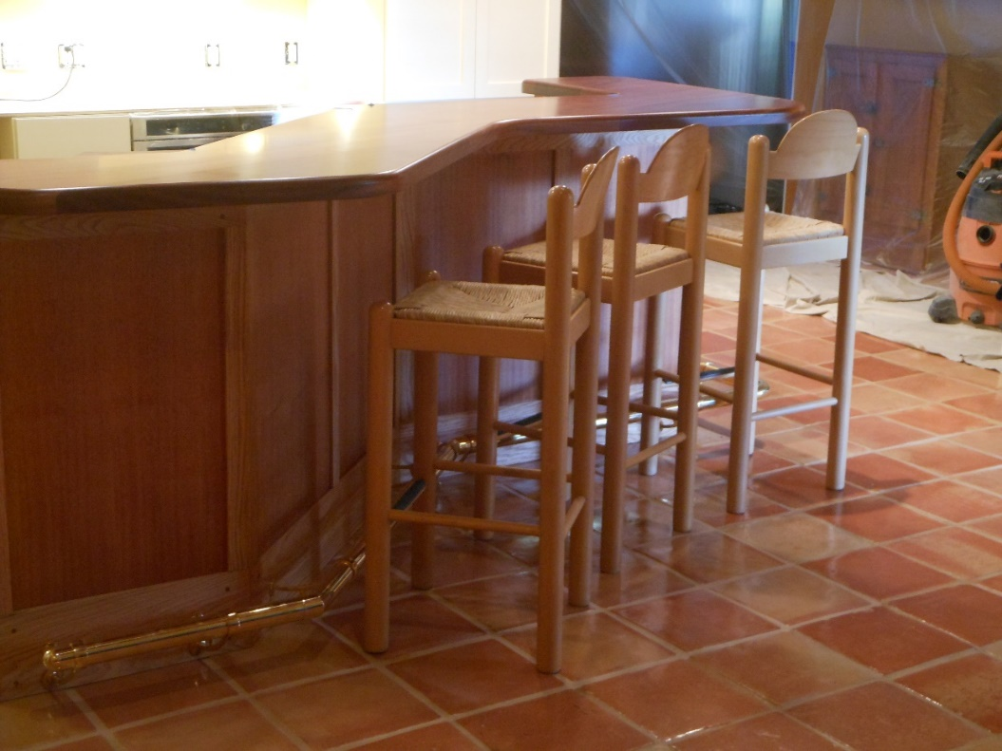
S/S Reefer in place, trying out the bar stools
It took two tries to get Sears to deliver an unblemished refrigerator, but they finally got it right.
These bar stools are leftovers. We had three from the old kitchen and three from the townhouse in Lighthouse Point.

Slide 31
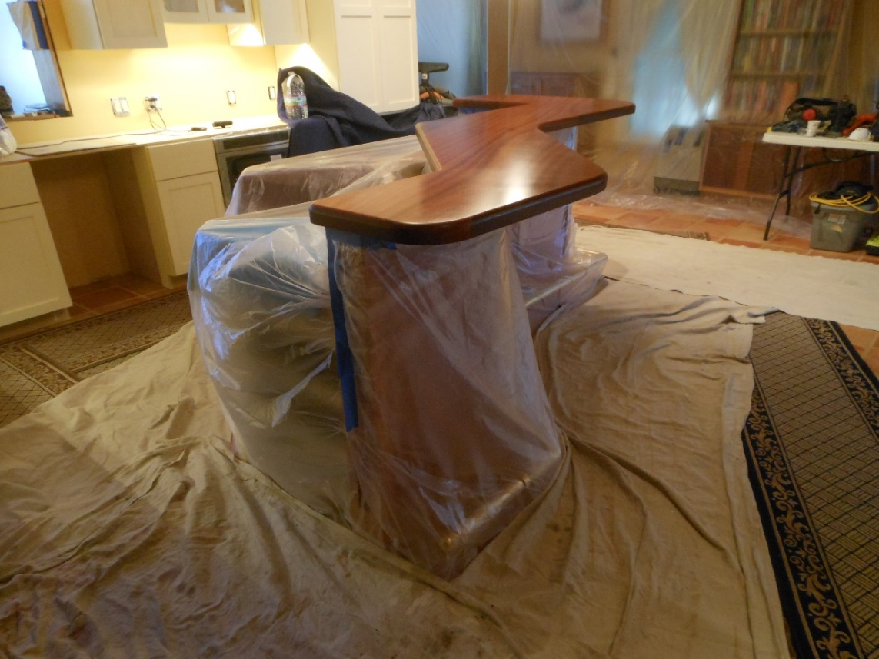
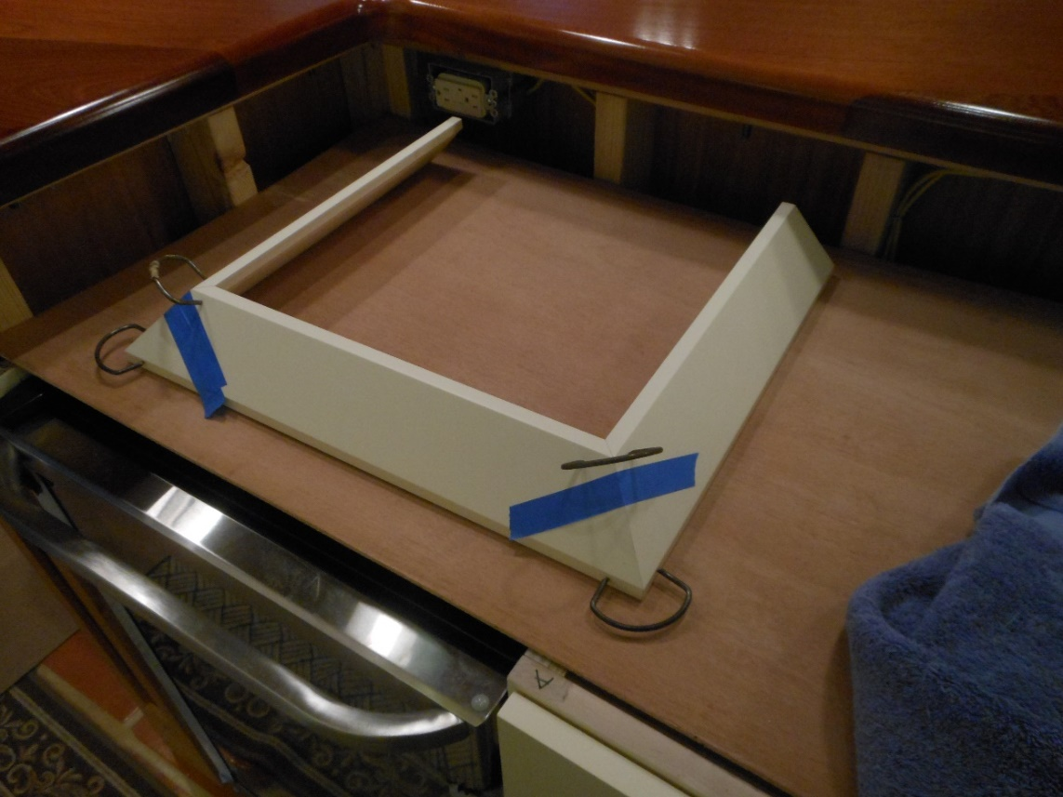
Prep for final coats, crown mold pre-assembly

Slide 32
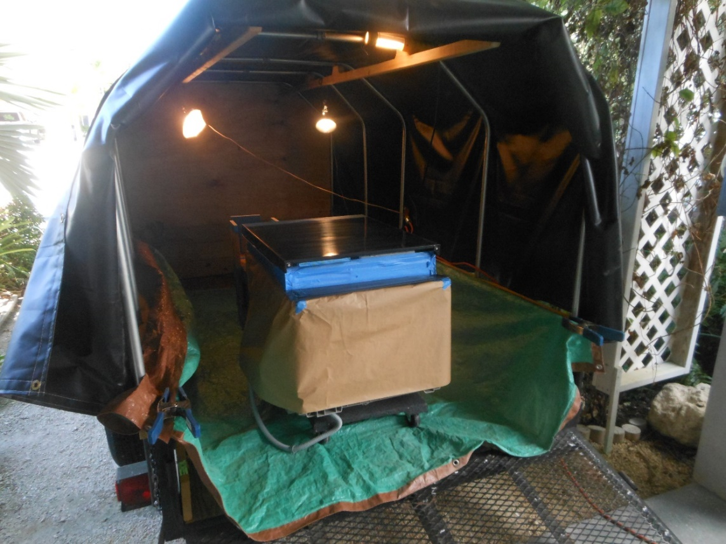
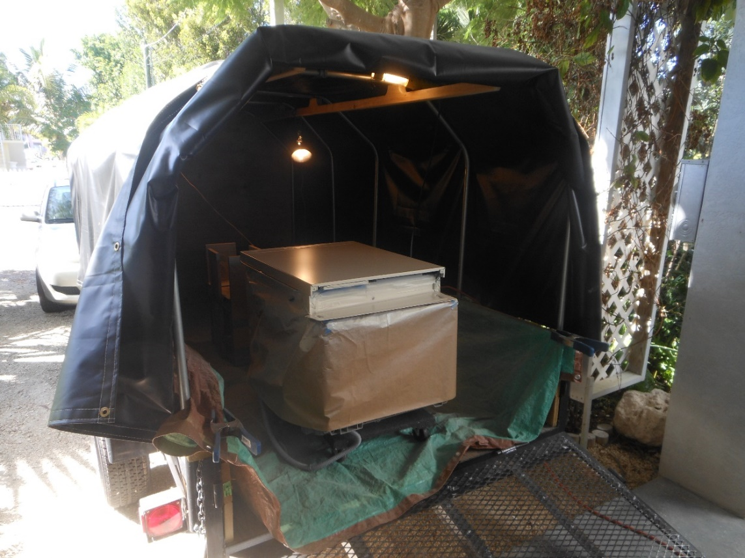
Trailer converts to paint stall, dishwasher before and after using exact cabinet paint.

Slide 33
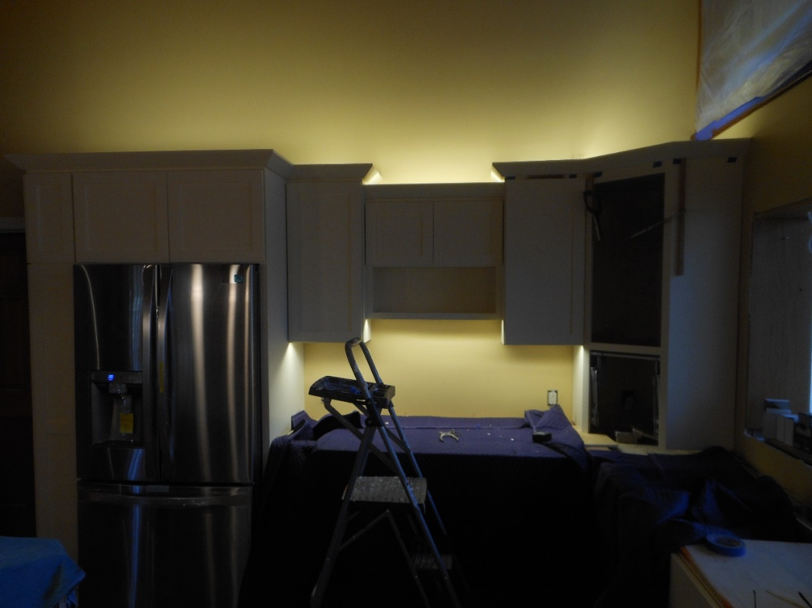
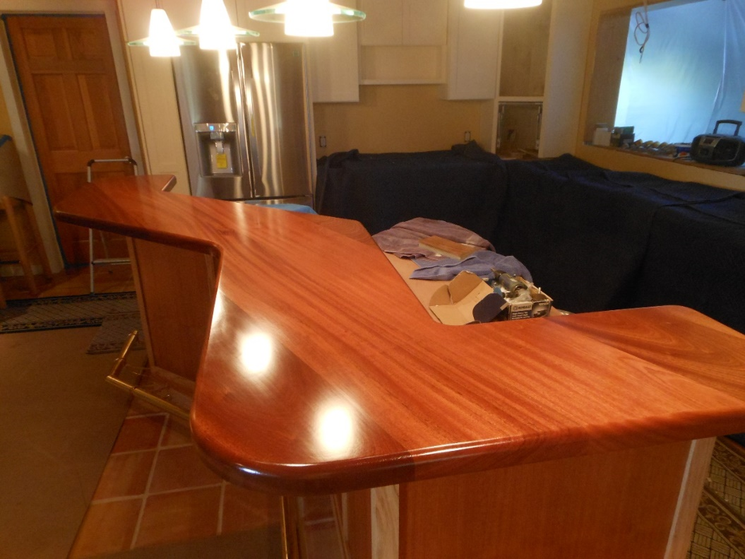
Crown molding goes up, mahogany glistens
John said he learned a lot from Derrick with respect to putting the crown molding up, such as gluing all corners beforehand.
Neat, clean craftsmanship marks every nook and cranny of this kitchen. We are extremely happy with this collaboration.

Slide 34
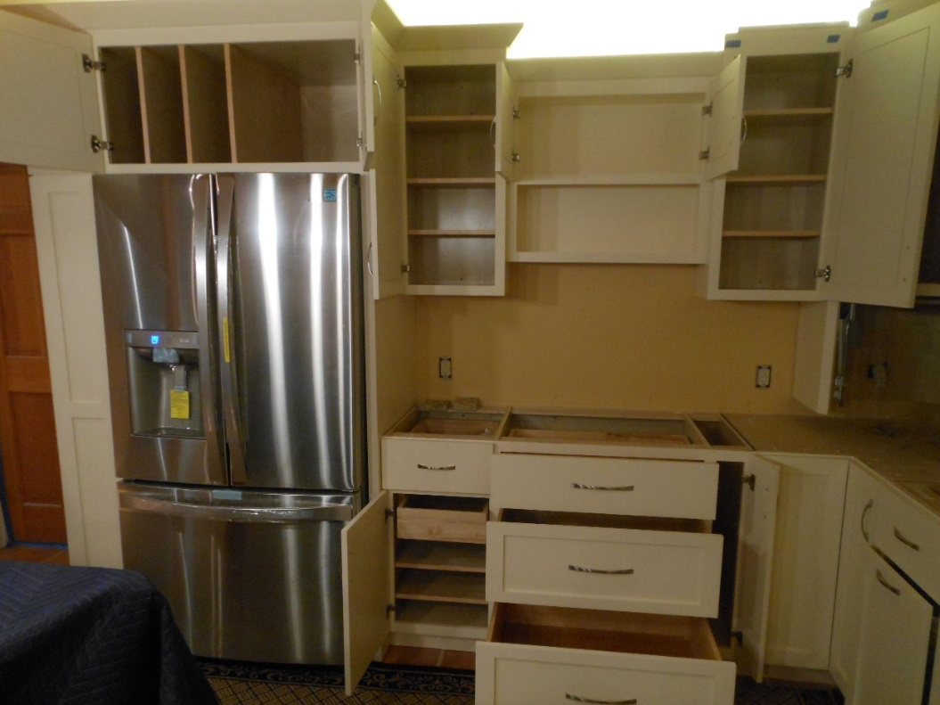
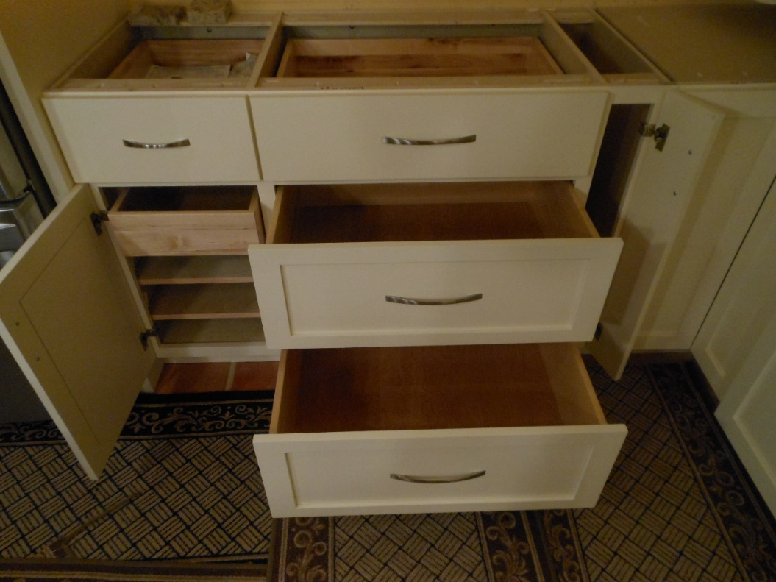
Well-planned storage galore.
Notice the deep spaces above the refrigerator for trays on the left, and large rarely used items on the right.
Pots and pans will fill the two big drawers, while the other spaces are filled with custom-designed storage innovations.

Slide 35
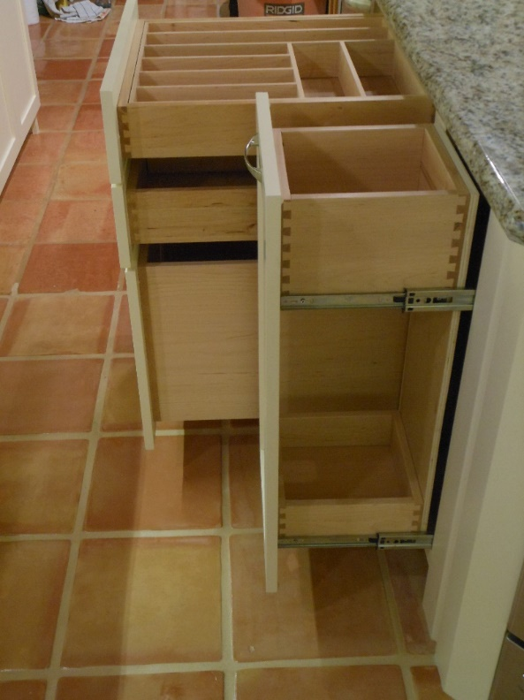
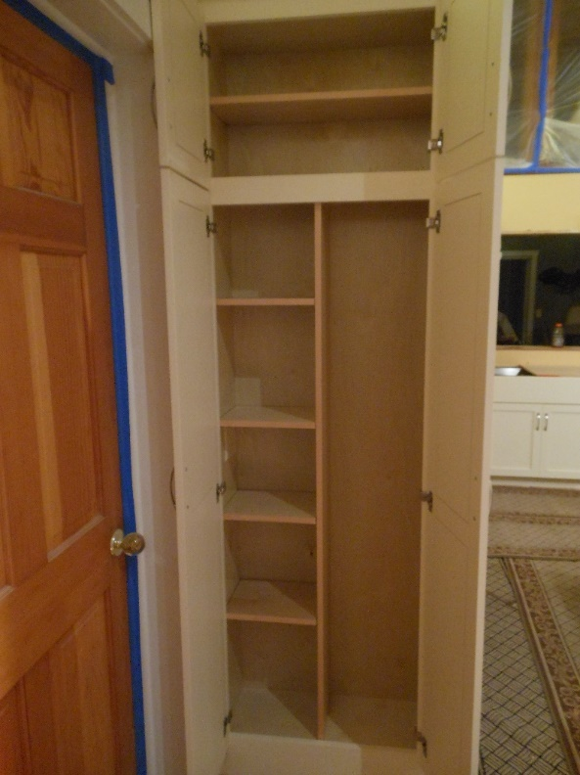
More storage . . .
The drawer nearest you is our own idea, designed to hold kitchen utensils without taking up any counter space.
Another storage innovation involved storage for cleaning supplies, brooms and mops.

Slide 36
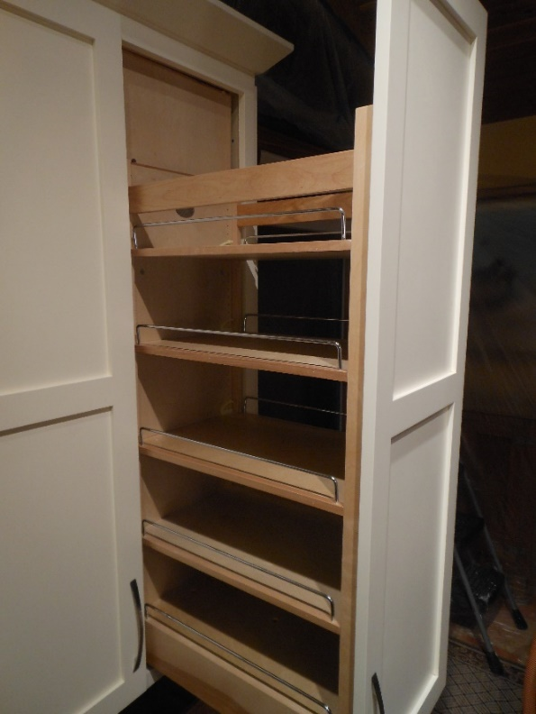
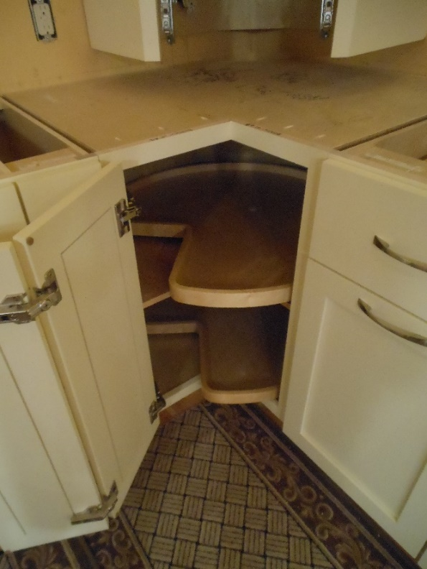
Still more storage! This required planning.
We have a huge pantry area. This shows roughly ¼ of the total space.
We placed a huge lazy susan between the sink and the food preparation area.

Slide 37
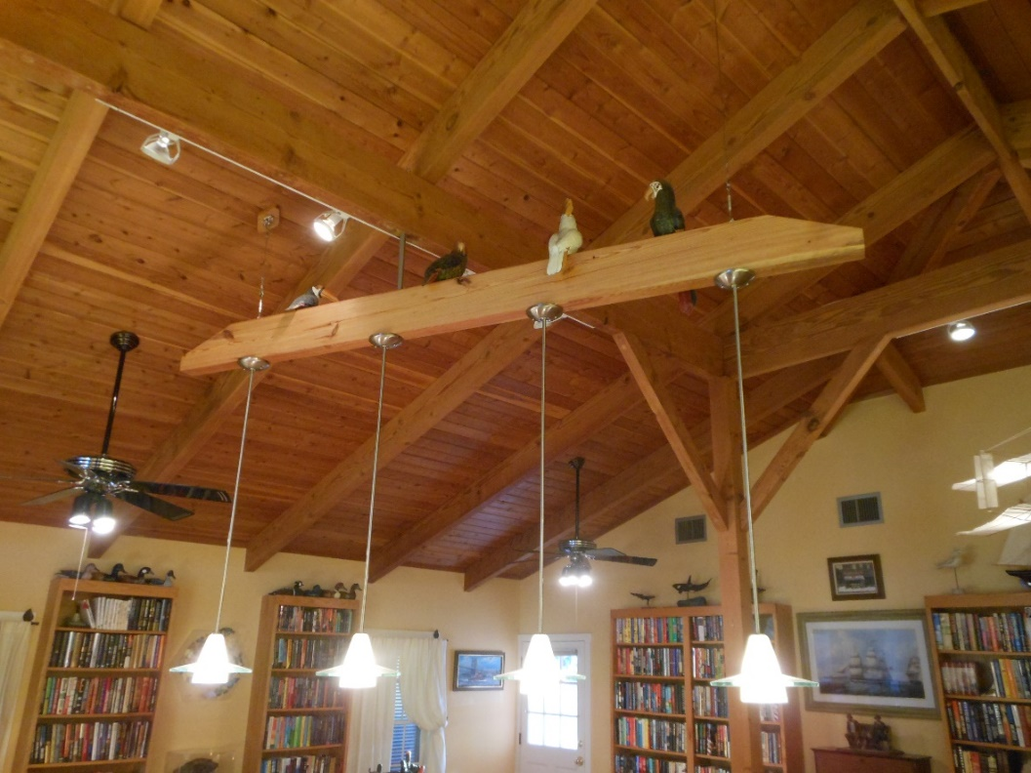
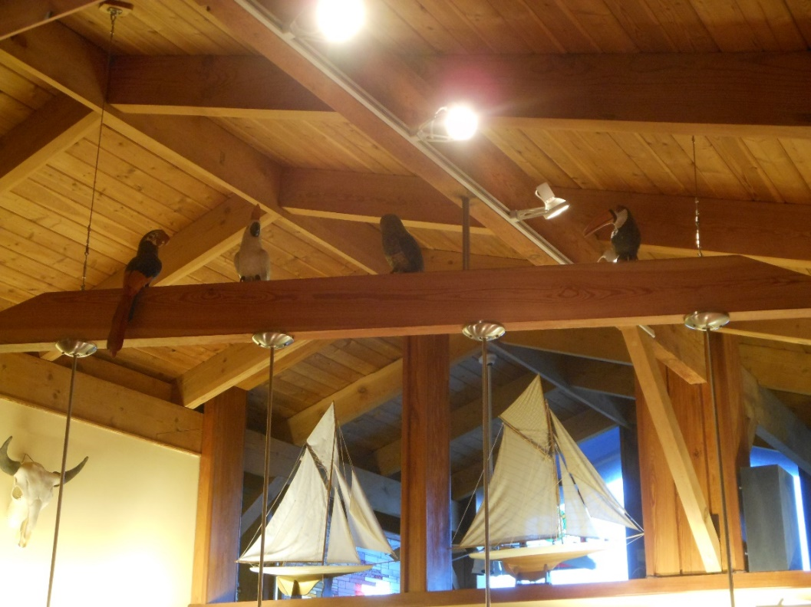
Birds perch on our lighting fixture
Love these carved leather birds! Couldn’t get rid of them, but we did not want them to block our view.
So, we reasoned, why not set them atop our fixture, where they fit perfectly. Notice the protective plastic is coming down.

Slide 38


Granite finishes the look
John made the final decision on this granite, travelling to Miami to find it and interviewing a number of shops.
We completely trusted John’s judgement in this area. He knew what we were shooting for, and he made a great choice.

Slide 39


Backsplash blends perfectly
We chose keystone for the backsplash as a nod to our special Keys environment. Keystone is fossilized coral.
Look at this perfect coordination. We are thrilled with this job in every respect. John is the best I have ever seen, bar none.

Slide 40


Check the custom lighting. Under-bar for mood, above the sink for clarity.
LED strips recessed into the underside of the mahogany provide atmosphere. There are many lighting combinations possible.
John found the exact matches to our existing lights, and built brackets to hold them over the sink.

Slide 41


John attended to every detail.
Notice the steer’s skull over the food preparation area, a leftover from the old kitchen.
We chose to keep and repaint the dishwasher because it was quiet and efficient. At one point, we chose a drawer.

